Slide 1
Designing a Future State to Account for Social Risk in CMS Payments
January 11, 2021 | 9:30 AM - 5 PM
A Workshop Hosted by:
The Center for Professionalism & Value in Health Care
The American Board of Family Medicine (ABFM) Foundation
Social Innovation Ventures
Notes:
Kevin

Slide 2
Housekeeping
How to use the chat
Group messages
Private messages
Muting and unmuting your microphone
Raising your hand
Turning your camera on and off
Introductions
Notes:
Kevin

Slide 3
Agenda
9:40-9:50 AM Opening Remarks
9:50-10:35 AM Review of Policy Objectives and Relevant Case Studies
10:35-10:45 AM Break
10:45-12:15 PM Group Visioning: Driver Mapping
12:15-1:00 PM Lunch
1:00-2:40 PM Testing Future States Against Drivers
Notes:
Tara

Slide 4
Agenda
2:40-2:50 PM Break
2:50-4:30 PM Developing a Plan for Action
4:30 PM Closing
Notes:
Tara

Slide 5
Key Takeaways
By the end of the workshop we will have:
An organized list of drivers we must consider as we test design a future state to account for social risk in CMS payments
Tested a variety of future states and selected one we feel is most reasonable as a group
A action plan for how to pursue this future state
Notes:
Tara

Slide 6
Opening Remarks
Bob Phillips, MD, The Center for Professionalism & Value in Health Care
Notes:
Bob

Slide 7
Policy Objectives
Notes:
Bob

Slide 8
A Future Policy That Accounts for Social Risk in CMS Payments Should...
Be adjusted for social determinants of health; the policy should aim to resolve patients’ social risk and support community interventions
Be proportional to area disadvantage and designed to address social needs, not just reflective of usual, related healthcare costs
Have geographic, small-area indices that are created based on patient and population outcomes, and will be a viable, reliable, sustainable mechanism for payment adjustments
Notes:
Copy and paste these into the chat:
A Future Policy That Accounts for Social Risk in CMS Payments Should…
Be adjusted for social determinants of health; the policy should aim to resolve patients’ social risk and support community interventions
Be proportional to area disadvantage and designed to address social needs, not just reflective of usual, related healthcare costs
Have geographic, small-area indices that are created based on patient and population outcomes, and will be a viable, reliable, sustainable mechanism for payment adjustments
Reduce burden for providers, payers, states and reduce inequities between states created by the current process
Have funders predefine the goals of reduced total cost and improved patient health outcomes at the outset and use these to titrate funding rather than simply looking for cost offsets that do not align with accountability or expectations of meeting SDH needs

Slide 9
A Future Policy That Accounts for Social Risk in CMS Payments Should...
Reduce burden for providers, payers, states and reduce inequities between states created by the current process
Have funders predefine the goals of reduced total cost and improved patient health outcomes at the outset and use these to titrate funding rather than simply looking for cost offsets that do not align with accountability or expectations of meeting SDH needs

Slide 10
Workshop Objectives
Notes:
Bob

Slide 11
In this workshop, we will test the potential for a policy by highlighting the objectives identified through a variety of potential future states by:
Summarizing current approaches that successfully incorporate social risk into healthcare payment in the US and abroad
Identifying creative approaches to incorporate social risk into healthcare payments for CMS
Developing action items to more deeply explore and potentially operationalize incorporation of social risk into healthcare payments for CMS
Codifying learnings from the Workshop and diffuse those learnings within HHS and to the broader healthcare ecosystem through publication in a peer-reviewed journal or conference presentation
Notes:
A Future Policy That Accounts for Social Risk in CMS Payments Should…
Be adjusted for social determinants of health; the policy should aim to resolve patients’ social risk and support community interventions
Be proportional to area disadvantage and designed to address social needs, not just reflective of usual, related healthcare costs
Have geographic, small-area indices that are created based on patient and population outcomes, and will be a viable, reliable, sustainable mechanism for payment adjustments
Reduce burden for providers, payers, states and reduce inequities between states created by the current process
Have funders predefine the goals of reduced total cost and improved patient health outcomes at the outset and use these to titrate funding rather than simply looking for cost offsets that do not align with accountability or expectations of meeting SDH needs

Slide 12
Review of Case Studies

Slide 13
Summary of Examples of Clinical Payment Adjustments
for Social Determinants
ENGLAND: Index of Multiple Deprivation
NEW ZEALAND: NZ Index of Multiple Deprivation
UNITED STATES:
Measures:
Area Deprivation Index (Wisconsin)
Social Deprivation Index (Graham Center)
Example:
Massachusetts
TOOLS for IMPLEMENTATION – U.S. Context
Population Health Assessment Engine (PHATE)

Slide 14
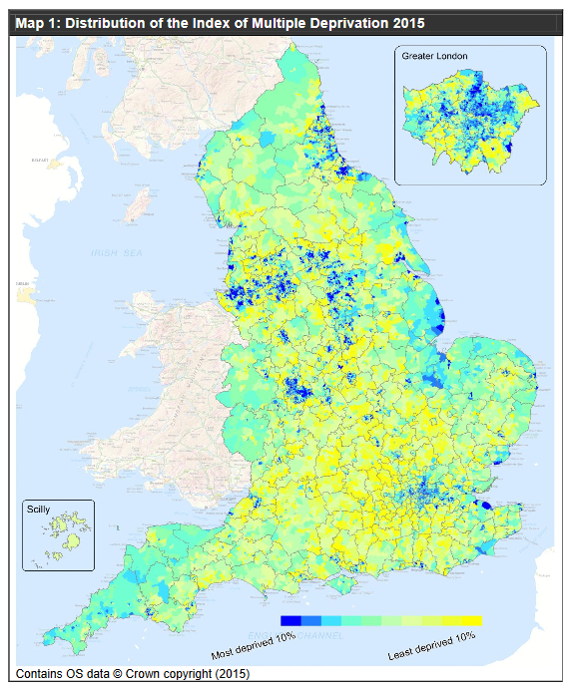
English index of multiple deprivation: Adjustments for Social Services
Seven deprivation domains:
Income Deprivation (22.5%)
Employment Deprivation (22.5%)
Education, Skills/Training Deprivation (13.5%)
Health Deprivation and Disability (13.5%)
Crime (9.3%)
Barriers to Housing & Service (9.3%)
Living Environment Deprivation (9.3%)
Each of these domains is in turn based on a basket of indicators
Thanks to Prof. Peter Smith, UK
Source: Ministry of Housing, Communities & Local Government (2015), English indices of deprivation 2015
https://www.gov.uk/government/statistics/english-indices-of-deprivation-2015
Notes:
‹#›

Slide 15

Resource Allocation Working Party 1976
Intention was to allow NHS patients ‘equal opportunity of access [to health care] for those at equal risk’
RAWP recommended distributing finance on the basis of population, weighted according to demography and disease-specific standardized mortality rates

Slide 16
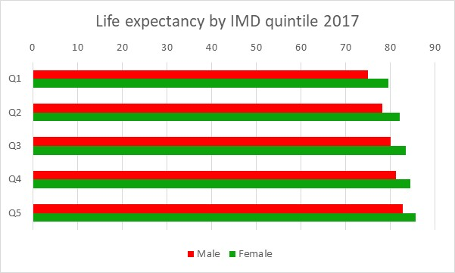
Life expectancy in England by deprivation quintile: Gap Q1 to Q5: males 7.7 years; females 6.2 years (FYI, differences MUCH smaller than in the US which Sir M. Marmot attributed to differences in Primary Care)
Source: Office for National Statistics (2019), Health state life expectancies by national deprivation deciles, England and Wales: 2015 to 2017
Notes:
Data are as follows: in summary Q! M 75.0, F79.5; Q5 M82.8, F85.7
Male Female
Q1 75.0488 79.524655
Q2 78.11815 82.04633
Q3 80.0785 83.389265
Q4 81.3335 84.435745
Q5 82.77925 85.68148
‹#›

Slide 17
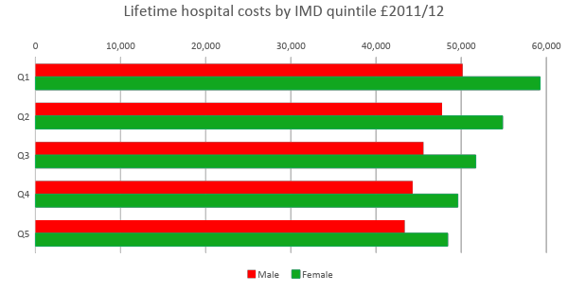
Hospital care higher, even though more deprived quintiles have lower life expectancy
Source: Asaria M, Doran T, Cookson R. 2016, “The costs of inequality: whole-population modelling study of lifetime inpatient hospital costs in the English National Health Service by level of neighbourhood deprivation”, J Epidemiol Community Health
doi:10.1136/jech-2016-207447

Slide 18
Examples of small area needs variables that survived statistical selection process (2013)
The small area variables indicate expenditure on medical services not predicted by the age, sex and previous diagnosis variables
Reflect prevalence of social or health characteristic of the population in the small area
Selected using statistical predefined selection algorithm, reduced 167 candidate variables to a manageable number
Persons in social rented housing (+)
Disability allowance claimants (+)
People aged 16–74 years with no qualifications (age standardized) (+)
Mature city professionals (-)
Students in population (-)
Asthma prevalence (+)
Dixon, J., Smith, P., Gravelle, H. et al, (2011), “A person-based formula for allocating commissioning funds to general practices in England: development of a statistical model”, British Medical Journal, 343:d6608 doi: 10.1136/bmj.d6608

Slide 19
NHS equity criteria shift (This is REALLY Important)
The conventional criterion: to allocate the fixed National Health Service budget to geographical areas:
to secure “equal opportunity of access [to NHS services] for those at equal risk”
A revised criterion (2001):
“to contribute to the reduction in avoidable health inequalities”

Slide 20
“To contribute to the reduction in avoidable health inequalities”
An implication that the current outcomes of NHS care are unacceptable
Desire to shift NHS resources towards areas with the poorest health outcomes.
Limited scope for using empirical data – by definition, current NHS actions are not securing desired outcomes.
How much of poor health outcomes can be addressed by health services?
Hauck, K., Shaw, R. and Smith, P. (2002), “Reducing avoidable inequalities in health: a new criterion for setting health care capitation payments”, Health Economics, 11(8), 667-677.

Slide 21
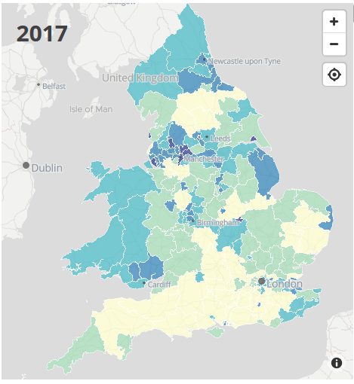
Age-standardised amenable mortality rates amongst CCGs
Bradford City 186.6/100k
Surrey Heath 52.2/100k
How much more funding should Bradford City receive to reduce this gap?

Slide 22
Current approach to allocating for ‘unmet need’
Based on policy judgement, not evidence
Applied to a percentage of the relevant budget:
General acute and mental health services 10%
Primary care 15% (This is 3x higher than in the US, BTW)
Specialized services 5%
Allocated according to standardized mortality rate (aged under 75) in small areas (average population 7,200)
16 groups of small areas, ranked according to mortality (SMR)
A weight per head 10 x higher for area with the worst SMR vs. area with the lowest SMR, exponential scale

Slide 23
English index of multiple deprivation: Adjustments for Social Services
Seven deprivation domains:
Income Deprivation (22.5%)
Employment Deprivation (22.5%)
Education, Skills/Training Deprivation (13.5%)
Health Deprivation and Disability (13.5%)
Crime (9.3%)
Barriers to Housing & Service (9.3%)
Living Environment Deprivation (9.3%)
Each of these domains is in turn based on a basket of indicators
Source: Ministry of Housing, Communities & Local Government (2015), English indices of deprivation 2015
https://www.gov.uk/government/statistics/english-indices-of-deprivation-2015
Notes:
‹#›

Slide 24
Some criteria for funding formulae
Based on universally available, validated data;
Reflects the underlying social and medical needs in a locality;
Independent of previous spending in a locality;
Scientifically coherent and plausible;
Feasible, with low administrative cost;
Not vulnerable to manipulation or fraud;
Encourages efficient delivery of health services, and free from perverse incentives;
Transparent, verifiable, understandable and replicable;
Parsimonious;
Reflects policy intentions

Slide 25

New Zealand has done similar
‹#›
Notes:
‹#›

Slide 26
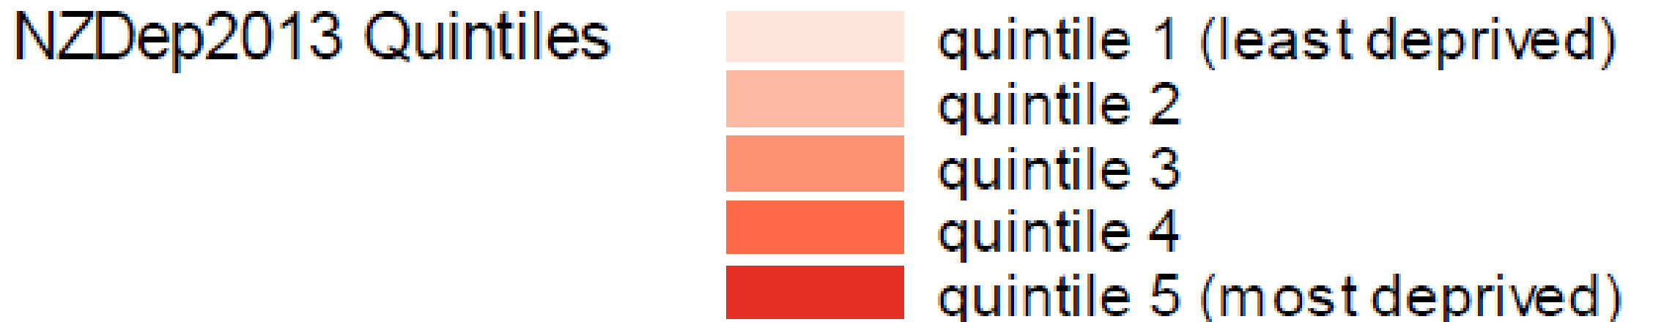
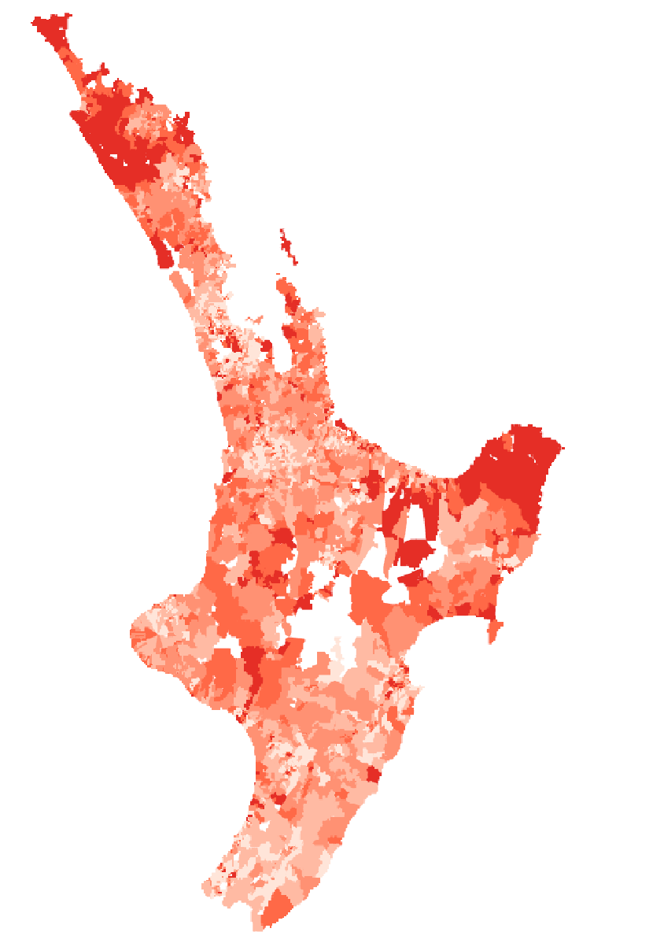
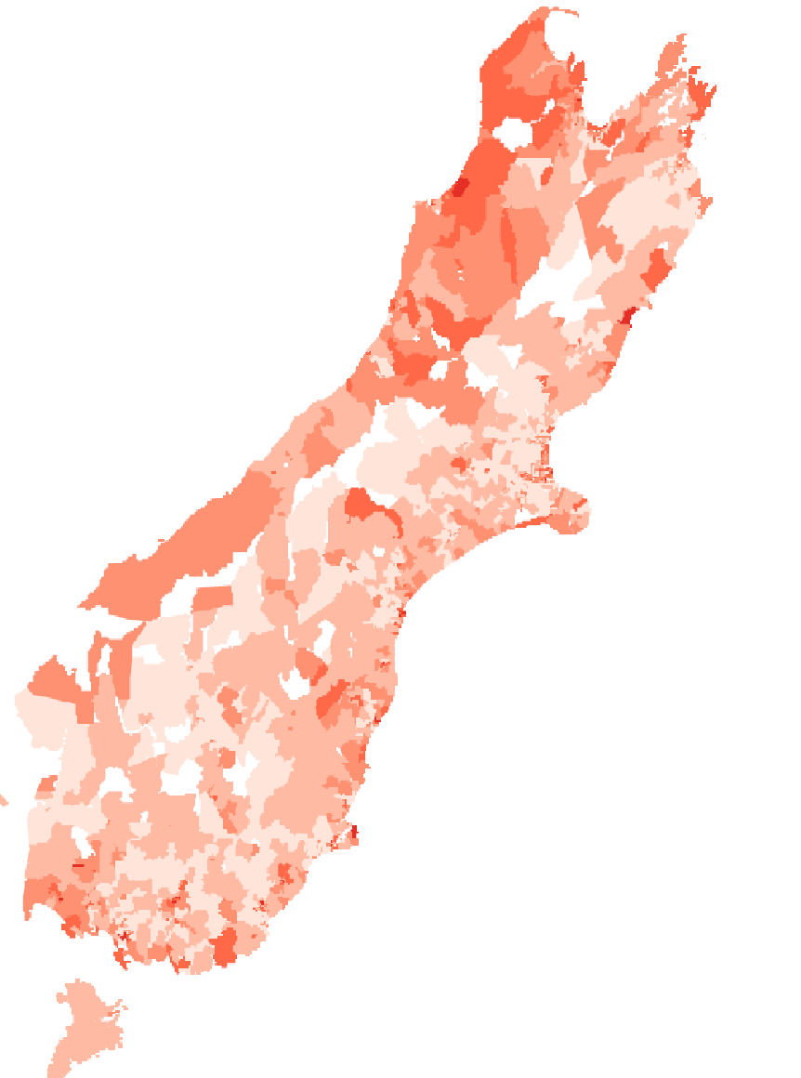
“NZDep2013 Index of Deprivation,” June Atkinson, Clare Salmond, and Peter Crampton, published by the Department of Public Health, University of Otago, Wellington, May, 2014. http://www.otago.ac.nz/wellington/otago069936.pdf

Slide 27
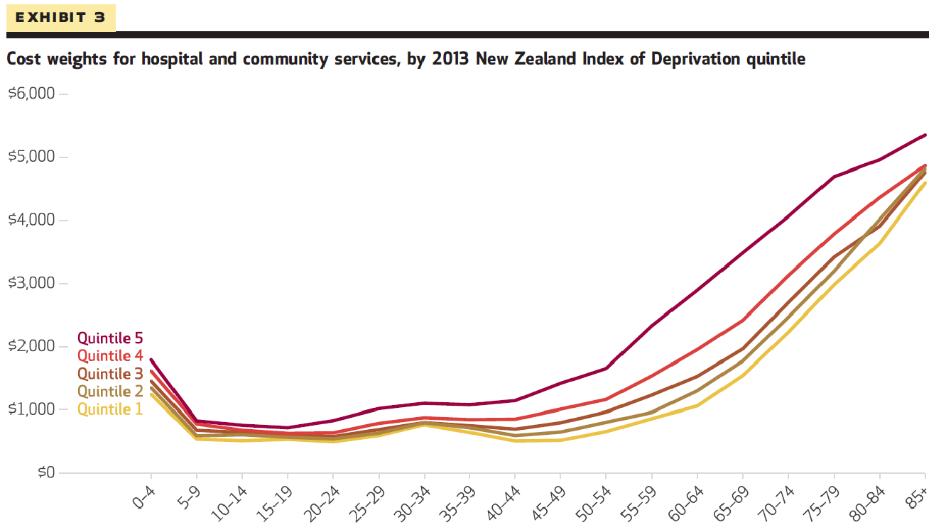
Payment adjustments geared to resolving inequity, nearly exponential for most deprived

Slide 28
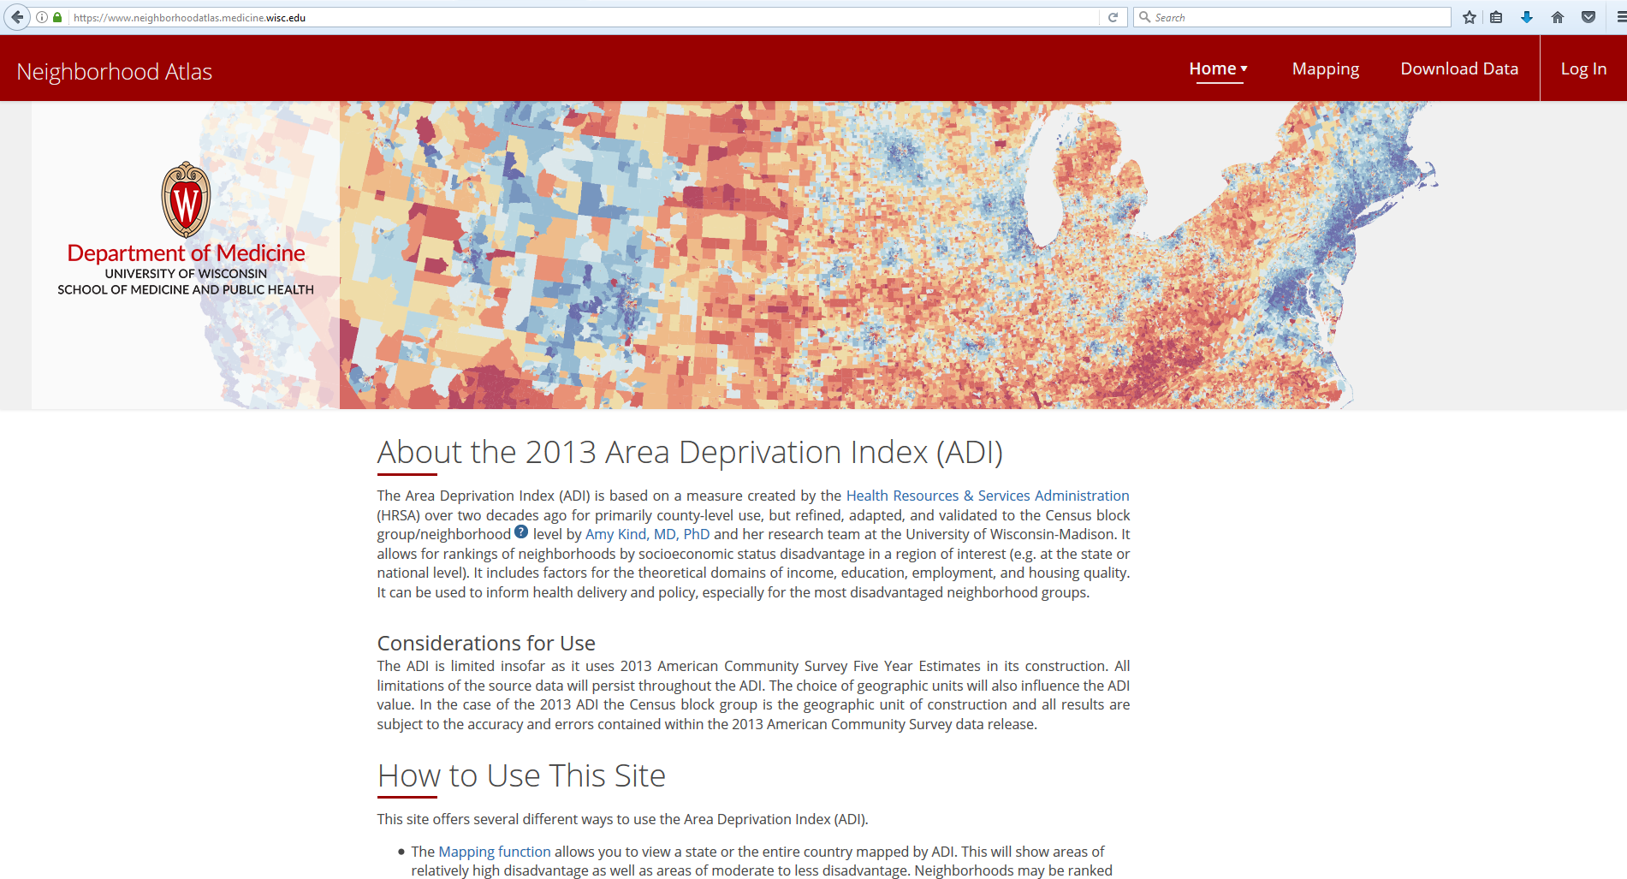
Neighborhood Atlas (Thanks to Dr. Amy Kind)
https://www.neighborhoodatlas.medicine.wisc.edu/

Slide 29

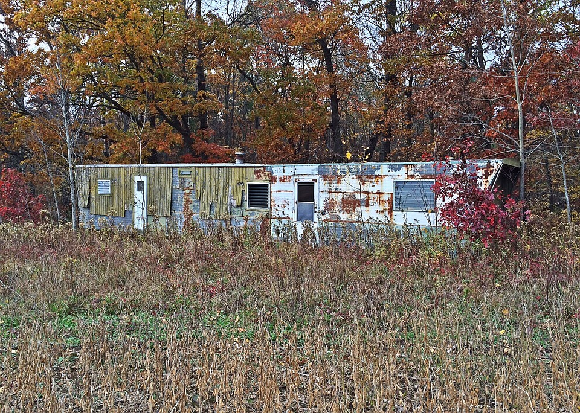
Neighborhood Disadvantage
Alzheimer’s disease, diabetes, heart disease and many other conditions disproportionately impact racial/ethnic minorities and the socioeconomically disadvantaged—populations often exposed to neighborhood disadvantage, a social determinant of health
[Link & Phelan, J Health Soc Behav, 1995; ]
Neighborhood disadvantage influences many factors including health behaviors, access to food, toxic exposures and personal safety
[Link & Phelan, J Health Soc Behav, 1995; House et al, Milban Q, 1990; Franco et al, Am J Prev Med, 2008; and others]
Living in a disadvantaged US neighborhood is strongly linked to increased mortality and disease
[Kind et al, Annals of Int Med, 2014; Link & Phelan, J Health Soc Behav, 1995; House et al, Milban Q, 1990; and others]
Source: www.Pixabay.com-- All images are released free of copyrights under Creative Commons CC0
Notes:
‹#›

Slide 30
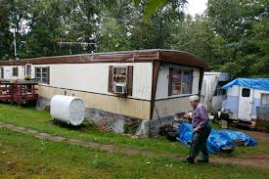
Potential of Geospatial Metrics of Neighborhood Disadvantage
Metrics of Neighborhood Disadvantage are Robust:
Generalizable to full US and Puerto Rico
Incorporate into predictive analytics
Facilitate mechanistic science across health conditions
Privacy-compliant
Strong track record of application – mostly abroad
Translatable: Actionable at person, community, research and policy levels
Guide outreach, targeting- particularly through mapping
Influence intervention design, implementation
Policy-applicable: eligibility, adjustment, resources, etc
Underutilized: Yet, despite all this potential, greatly underutilized in the US-- not easily accessible nor always in a format that allows wide applicability
Source: www.Pixabay.com-- All images are released free of copyrights under Creative Commons CC0

Slide 31

Originally created by HRSA nearly three decades ago, county level
17 education, employment, housing-quality and poverty measures originally drawn from long-form Census
Limitations mirror those of parent data
Required updates for modern use
UW team:
Updated to more recent and relevant data sources (American Community Survey, 2009-13)
Refined down to census block-group level (i.e. “neighborhood” ~ 1,500 persons) which is critical to more precisely measure exposure
NIH R01 to validated these changes with users across US
Area Deprivation Index
(ADI)
Source: www.Pixabay.com-- All images are released free of copyrights under Creative Commons CC0

Slide 32
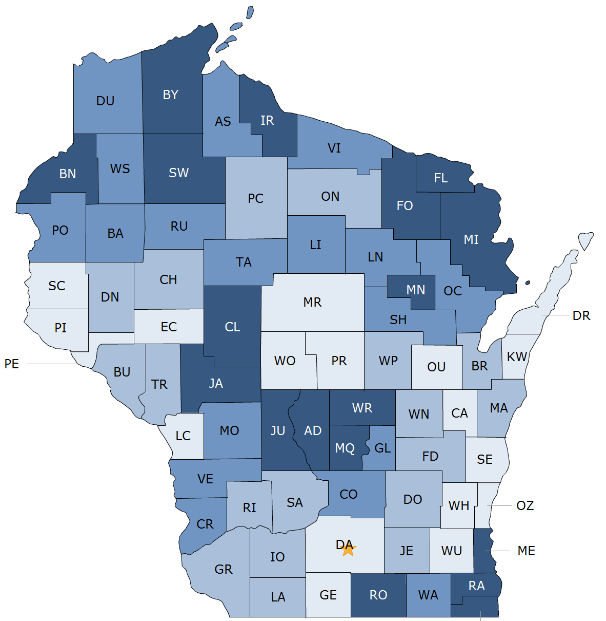
Typical
Geo-Political Boundaries Employed in Identification of Contextual Disadvantage
Blue worse
White better

Slide 33
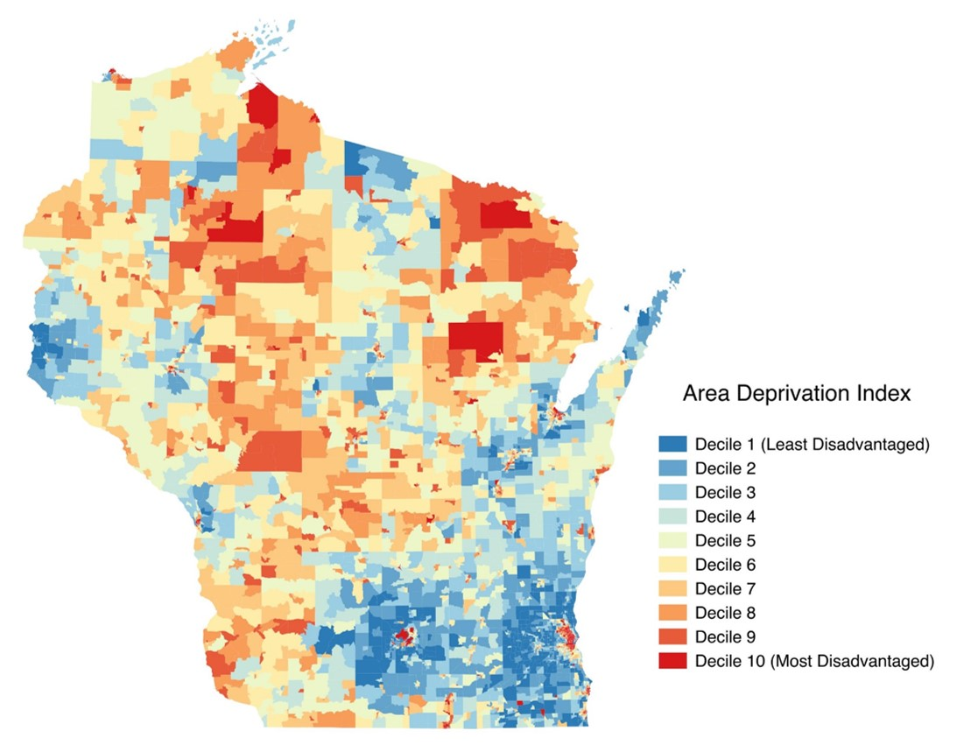
Neighborhood Disadvantage by ADI

Slide 34
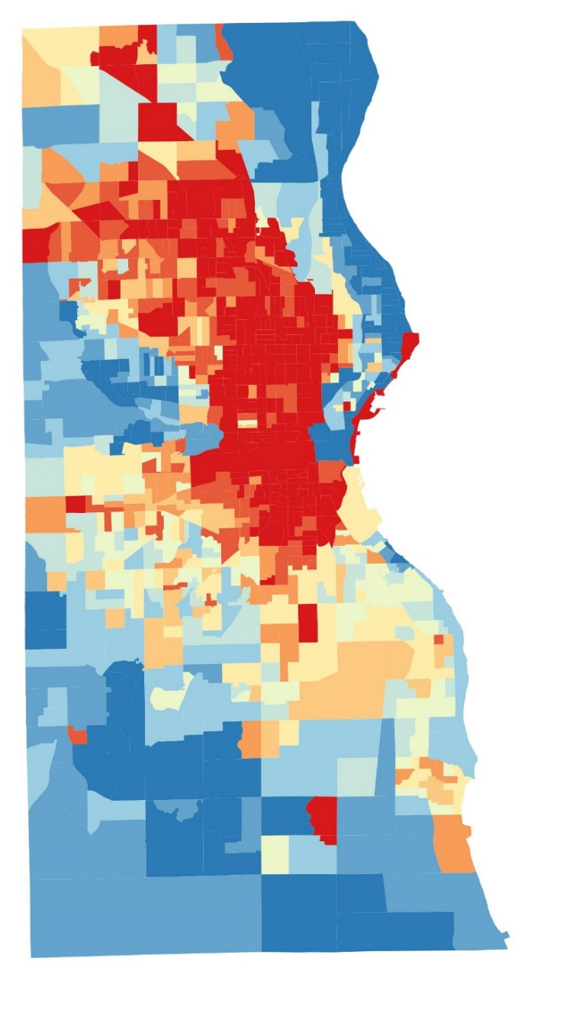

Milwaukee County

Slide 35
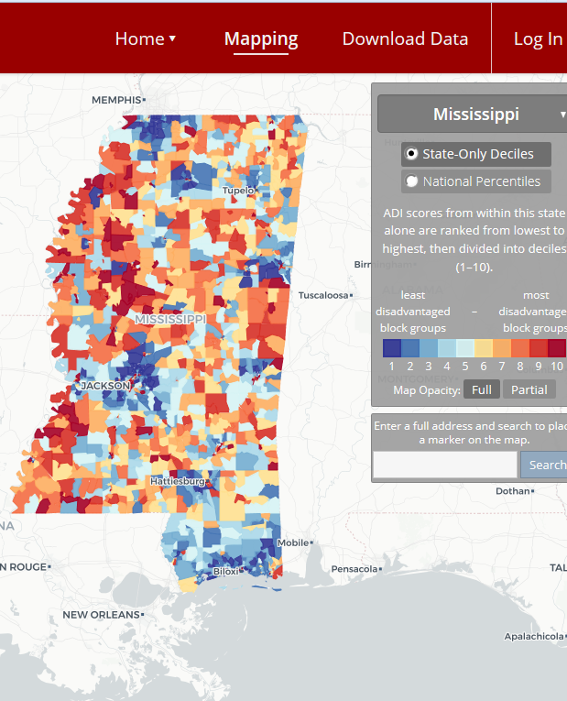
https://www.neighborhoodatlas.medicine.wisc.edu/

Slide 36
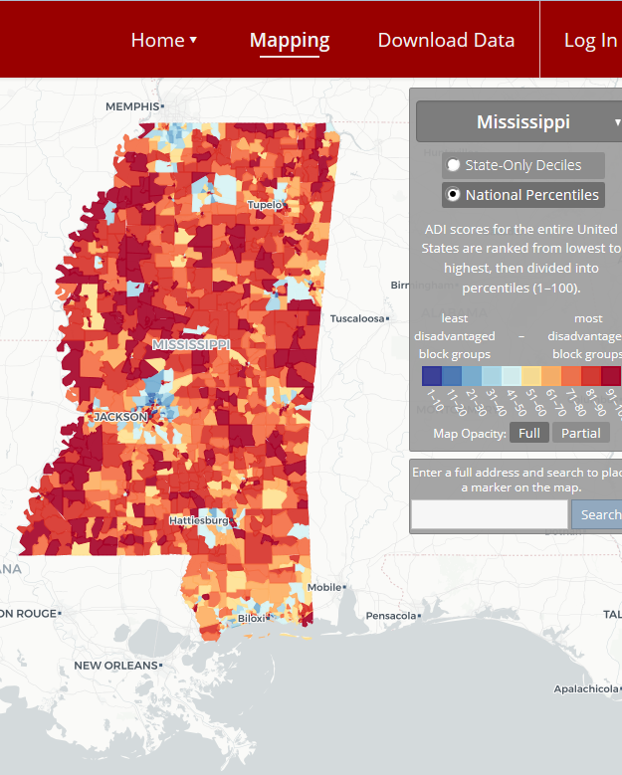
https://www.neighborhoodatlas.medicine.wisc.edu/

Slide 37
Data Democratization
Making complex data easily available to wide-reaching expert and non-expert audiences to massively broaden uptake and use of critical concepts and tools
Extremely challenging to practically achieve due to technical challenges of big data
Source: www.Pixabay.com-- All images are released free of copyrights under Creative Commons CC0

Slide 38
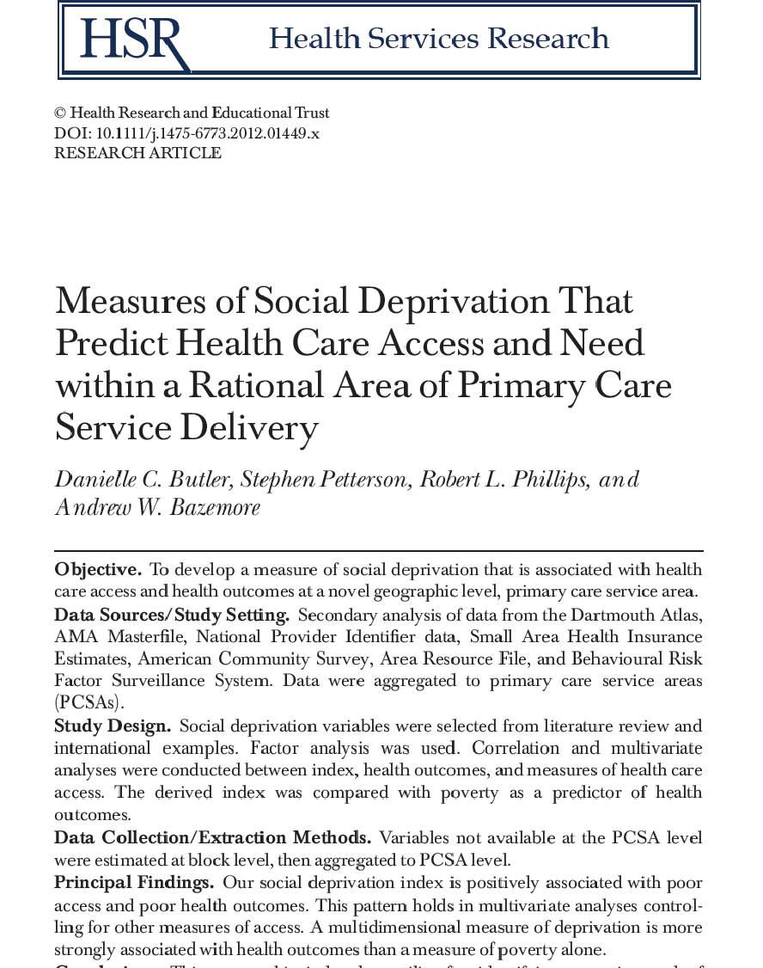
Social Deprivation Index
‹#›

Slide 39
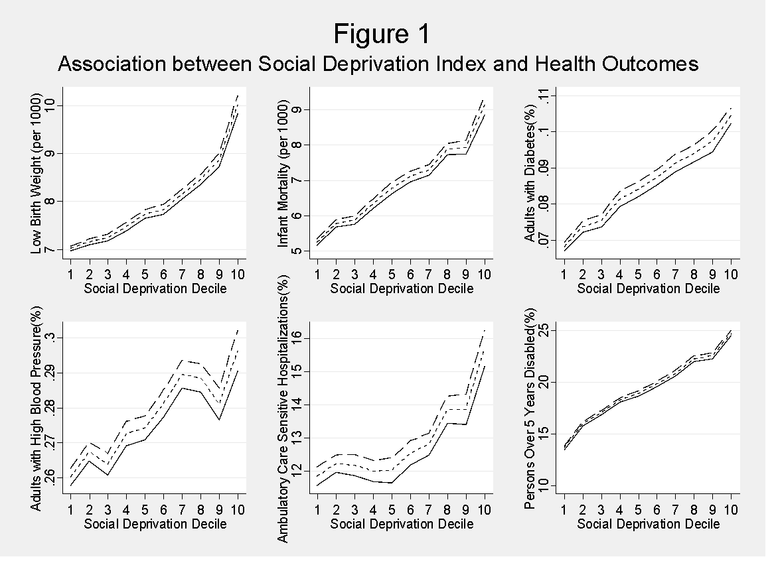
Notes:
‹#›

Slide 40

Population Health AssessmenT Engine
PHATE
Notes:
The ABFM is proposing to work with the Robert Graham Center and HealthLandscape, its sister center in the AAFP, to develop the Population Health Assessment Tool (PHAsT).
WE want to do for you what the UDSMapper did for health centers
‹#›

Slide 41
What is PHATE?
Uses EHR and Community data to:
Map physician or clinic service area
Display “Community Vital Sign” and elements for each neighborhood
“Community Vital Sign” for each patient
Show clusters of disease
Show clusters of poor outcomes
Identify community partners (Aunt Bertha)
Preparing to align SDOH-adjusted payments with tools to identify patients with social needs
Notes:
Family physicians enrolled in the registry would have the option of using PHAsT to
define their clinical service area,
understand which neighborhoods are most dependent on them,
look at disease and quality clusters (‘hotspots’), and to draw on social determinant data to develop community vital signs for patients, and to
look at risk of poor health across their community.
‹#›

Slide 42
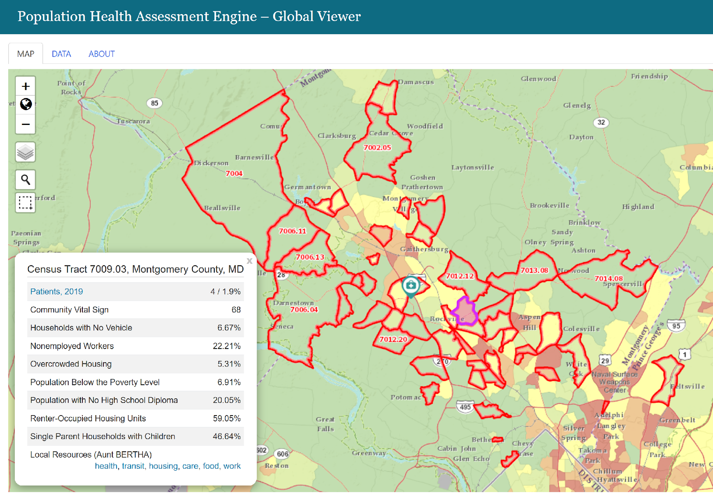

Slide 43
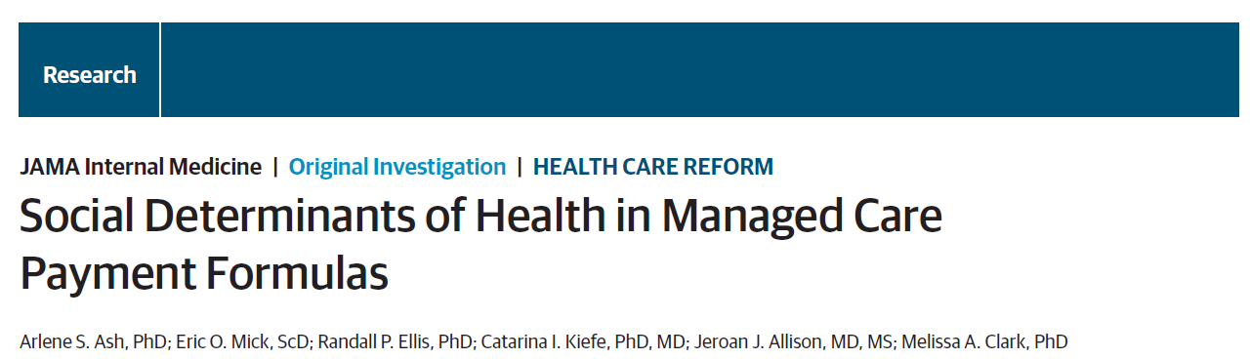
Thanks to Matthew Alcusky
Ash AS, Mick EO, Ellis RP, Kiefe CI, Allison JJ, Clark MA. Social Determinants of Health in Managed Care Payment Formulas. JAMA Intern Med. 2017 Oct 1;177(10):1424-1430.
‹#›

Slide 44
SDH Variables derived from Administrative Data
Individual Level
Neighborhood Stress Score
Disability
Client of the Department of Mental Health
Client of the Department of Developmental Services
Medicaid due to disability
Serious mental illness
Substance use disorder
Housing Problems
Homelessness by ICD-10 code
Housing instability (>3 addresses)
A measure of “economic stress” summarizing 7 census variables:
- % of families with incomes < 100% of FPL
- % < 200% of FPL
- % of adults who are unemployed
- % of households receiving public assistance
- % of households with no car
- % of single parent households
- % of people >25 without a HS degree
‹#›

Slide 45
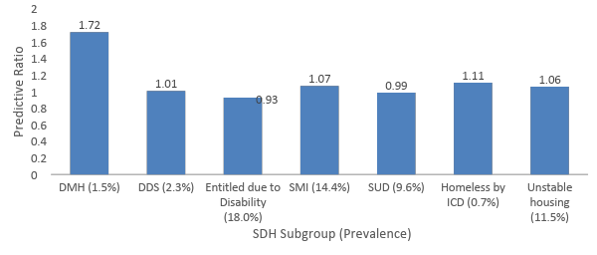
Observed/Expected Costs without Adjustment for SDH
$4320 underpayment per person on a $6,000 budget
$420 underpayment per person on a $6,000 budget
$660 underpayment per person on a $6,000 budget
‹#›
Ash AS, Mick EO, Ellis RP, Kiefe CI, Allison JJ, Clark MA. Social Determinants of Health in Managed Care Payment Formulas. JAMA Intern Med. 2017 Oct 1;177(10):1424-1430.

Slide 46
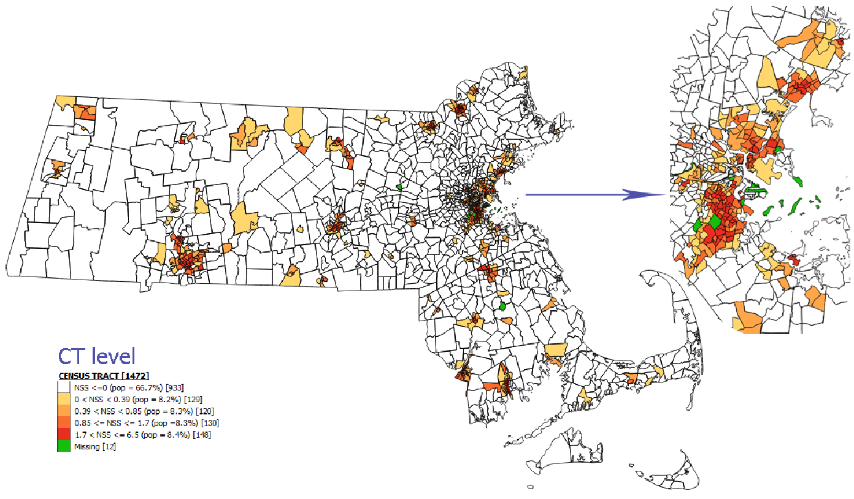
Incorporating SDH Variables into Payment Formulas
*Diagnosis based risk adjustment underpredicted costs for those in the most stressed quintile of neighborhood stress by $130 per-member per-year
‹#›

Slide 47
The Massachusetts DSRIP Program¹: 2017-2022
$1.8 billion DSRIP funds
Startup/ongoing payments
Flexible services payments
27 Community Partners (CPs)
$547 million
17 Medicaid ACOs
$1.1 billion
Statewide Investments
$115 million
Flexible services payments
9 LTSS CPs
18 Behavioral Health CPs
Social Service Organizations
Care planning, care coordination for members with complex needs
Nutritional, housing supports to address health related social needs
‹#›
1Massachusetts DSRIP Protocol. Accessed 05/30/2019. https://www.medicaid.gov/Medicaid-CHIP-Program-Information/By-Topics/Waivers/1115/downloads/ma/MassHealth/ma-masshealth-appvd-dsrip-prtcl-20190408.pdf

Slide 48
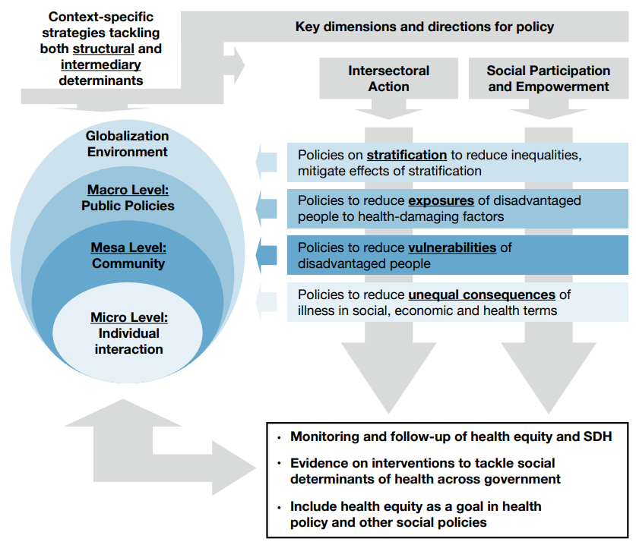
Target Sites of Action: The Massachusetts DSRIP Program
Reduced exposure to poor housing & nutrition
Intersectoral integration, increased safety net workforce, population health management
Improved identification and tracking of SDH needs, evidence generation
‹#›

Slide 49
Short Break

Slide 50
Small Group Exercise
Thinking Through and Mapping Drivers

Slide 51
What is a Driver?
Drivers are the political, economic, societal, technological, legislative and environmental (PESTLE) factors that are shaping the future of a policy area.
For example:
Political: Medicare age eligibility potentially decreasing
Environmental: Increased effects of global warming
Technological: Uptake in telehealth
Notes:
Driver Mapping is used to identify the political, economic, societal, technological, legislative and environmental drivers (PESTLE) shaping the future business environment

Slide 52
Activity Breakdown
Sort into breakout rooms with facilitators (1 minute)
Generate a list of relevant drivers with your group (~20 minutes)
Map those drivers onto a matrix to think through importance and predictability of those drivers (~25 minutes)
We will come back together as a group to share and refine to build a master matrix (~40 minutes)
Notes:
Link to mural:

Slide 53
Group 1
Facilitator: Bob

Slide 54
Driver Mapping Activity Goal
OUR goal is to come up with as many drivers as possible. Think quantity, not quality.
There is no wrong way to answer. We will filter out any drivers we don’t find relevant as a group by the end of the activity.

Slide 55
Driver Mapping: Create Your Own List
Please take up to 5 minutes to write down as many political, economic, societal, technological, legislative and environmental drivers as you can individually. Don’t worry if you can’t come up with drivers for a category or have more in one than another.
When you are finished, please send them to me through the Zoom chat so we can discuss them in the next part of this exercise as a group.
Your answer might look something like… - Technological drivers: Telehealth increase, AI health decision-making - Societal: Low health literacy of low SES populations - Economic: High unemployment rate
Notes:
Facilitator leave this slide up for the 5 minutes.
Legislative: Authority to pay for services
Political Medicaid expansion
P/E/E: Housing affordability/availability
P/E/E: Redlining
Technological: WIFI availability
P: Medicare for all, affordable housing
P/E/E: health inequalities; biased algorithms and policies; shrinking middle class; policy tensions between poor and middle class; transparency of algorithms
Eviron: places to exercise safely
E: decarceration
T: community health workers
?: care coordination
E: pollution;breathable air
universal, excellent pre-school
Shifts from FFS to MA; Data Accuracy (perception vs reality); digital data collection; use of advanced analytics; immigration policy; student loan forgiveness in relation to debt and wealth; race relations in the US; COVID-19 outcomes
immigration reform
universal, excellent pre-school
minimum livable wage
Availability of well paying jobs and training programs and/or adapted employment for people with disabilities, mental illness, etc.
no barriers to preventive care
Availability of interpreters
Availability of interpreters
Availability of community resources to learn English
good public transit
parks, greenspace
women's reproductive health; gentrification, farming in middle America
adequate drug and mental health care
Post secondary education - available & affordable
deepened opioid crisis
Criminal justice systems and decriminializing mental health, substance use, homelessness, and other low level offenses and offering non CJ alternative supports
reduced racial animosity
training in "critical thinking"
focus on Care for aging populations
more civiility
Aging in place is a large component of our aging policy in Minnesota
Support for Care Transitions/Coordination across settings; Focus on Wellness and Prevention
support for independent living
Home Health/Home Dialysis
Low cost and supportively available pharmacies
intentional intergenerational communities with surrogate "grandparents" and young families
career ladders in health for poor folks

Slide 56
Driver Mapping: Share, Review, & Map as a Group
As a group, let’s review all of the drivers we have compiled. We will do this on the next slide in the speaker notes.
Once we have reviewed them, we will map them on a matrix on the slide.
Notes:
Facilitator flip to next slide

Slide 57
Driver Mapping, Group 1
More important for the policy area
WIFI availability/Internet connectivity/enabling telehealth
Housing affordability/availability
Redlining
Robust technical support for model implementation
Medicaid expansion
Race relations
Medicare for all
Access to healthy food
CHWs; community role in care models
places to exercise safely
universal, excellent pre-school+.
Jobs (Career ladders, CHWs, health careers)
minimum livable wage
Pay for activities that improve health of vulnerable populations (authority and incentives)
SMI and SUD equity in care
Deprivation index that suits purpose (items, geography)/algorithm bias/transparency
The outcome is uncertain
The outcome is certain
Immigration (inclusion)
Teachable moment: COVID-19 outcomes, maternal mortality (and relationship to inequities)
Decarceration (effective transitions, family impact pre/post incarceration)
Less important for the policy area
Notes:
Facilitator, please copy and paste participant answers below. For an easier view, drag up the bar above to give more space for speaker notes. (20 min)
After collecting all answers, as a group, delete duplicates, cluster words based on similar themes, and clarify definitions as needed. Then, review and decide where to place drivers deemed relevant on the matrix. You do not need to map all drivers. Feel free to add or delete text boxes above (25 min).
Legislative: Authority to pay for services
Political Medicaid expansion
P/E/E: Housing affordability/availability
P/E/E: Redlining
Technological: WIFI availability
P: Medicare for all, affordable housing
P/E/E: health inequalities; biased algorithms and policies; shrinking middle class; policy tensions between poor and middle class; transparency of algorithms
Eviron: places to exercise safely
E: decarceration
T: community health workers
?: care coordination
E: pollution;breathable air
universal, excellent pre-school
Shifts from FFS to MA; Data Accuracy (perception vs reality); digital data collection; use of advanced analytics; immigration policy; student loan forgiveness in relation to debt and wealth; race relations in the US; COVID-19 outcomes
immigration reform
universal, excellent pre-school
minimum livable wage
Availability of well paying jobs and training programs and/or adapted employment for people with disabilities, mental illness, etc.
no barriers to preventive care
Availability of interpreters
Availability of interpreters
Availability of community resources to learn English
good public transit
Political:
Word
Economic:
Word
Societal:
Word
Technological:
Word
Legislative:
Word
Environmental:
Word

Slide 58
Group 2
Facilitator: Kevin

Slide 59
Driver Mapping Activity Goal
OUR goal is to come up with as many drivers as possible. Think quantity, not quality.
There is no wrong way to answer. We will filter out any drivers we don’t find relevant as a group by the end of the activity.

Slide 60
Driver Mapping: Create Your Own List
Please take up to 5 minutes to write down as many political, economic, societal, technological, legislative and environmental drivers as you can individually. Don’t worry if you can’t come up with drivers for a category or have more in one than another.
When you are finished, please send them to me through the Zoom chat so we can discuss them in the next part of this exercise as a group.
Your answer might look something like… - Technological drivers: Telehealth increase, AI health decision-making - Societal: Low health literacy of low SES populations - Economic: High unemployment rate
Notes:
Facilitator leave this slide up for the 5 minutes.

Slide 61
Driver Mapping: Share, Review, & Map as a Group
As a group, let’s review all of the drivers we have compiled. We will do this on the next slide in the speaker notes.
Once we have reviewed them, we will map them on a matrix on the slide.
Notes:
Facilitator flip to next slide

Slide 62
Driver Mapping, Group 2
More important for the policy area
Data Standards / Interoperability / Societal
Health Equity / Covid
Federalism
Health and Social Service FUNDING
Health and Social Service ADMIN
Funding Caps
Cultural Competency
Access to Care
The outcome is uncertain
The outcome is certain
Health Literacy
Adjustment v. Staifying
Less important for the policy area
Notes:
Facilitator, please copy and paste participant answers below. For an easier view, drag up the bar above to give more space for speaker notes. (20 min)
State v. National - payment is national, but local is diff; tension of which policy actor should be implementing payment models
Inability to increase funding (P/ E driver) = FEDERALISM
Funding Caps (seperate from Federalism)
Data Capture and Share, structure / uniformity / standards individual level information of social services / needs (Tech/ societal)
Who “rules” standards - EHR’s or
Data Privacy, homelessness or poverty, pre-existing social needs and how that would inform insurance
CMS mandating collection of Zcodes and difficulty implementing due to incomplete EHRs
Health equity - maybe allow more data collection, maybe not (Political priority)
NYT Senator Dear Colleague - ID race, ethnicities, disparities and it’s treatment - integrated / not into payment programs (Legislative / Exec Branch)
COVID has brought disparity to the front; Health equity visible part of vaccine strategy; how to communicate and implement it
Health literacy - accessing care, receiving treatment
Access to Care - are we thinking upstream enough (societal)
Health services focus not Social Services component; will it be ineffective without the other - wrong pocket problem, spend money in education and save money in health outcomes; coordinating admin and funding levels
Integrating health and social service ADMIN
Integrating health and social service FUNDING
Are we adjusting for social needs or just stratifying for social need? If your just adjusting for social needs your masking social disparities; if stratifying than other issues; CMS has integrated rural hospitals payments into their hospital Value-based purchasing system
Adjustment v. Stratification
How do international systems provide applicability towards U.S.? (side bar)
Modeling after international systems
After collecting all answers, as a group, delete duplicates, cluster words based on similar themes, and clarify definitions as needed. Then, review and decide where to place drivers deemed relevant on the matrix. You do not need to map all drivers. Feel free to add or delete text boxes above (25 min).
Political:
Word
Economic:
Word
Societal:
Word
Technological:
Word
Legislative:
Word
Environmental:
Word

Slide 63
Group 3
Facilitator: Andrew

Slide 64
Driver Mapping Activity Goal
OUR goal is to come up with as many drivers as possible. Think quantity, not quality.
There is no wrong way to answer. We will filter out any drivers we don’t find relevant as a group by the end of the activity.

Slide 65
Driver Mapping: Create Your Own List
Please take up to 5 minutes to write down as many political, economic, societal, technological, legislative and environmental drivers as you can individually. Don’t worry if you can’t come up with drivers for a category or have more in one than another.
When you are finished, please send them to me through the Zoom chat so we can discuss them in the next part of this exercise as a group.
Your answer might look something like… - Technological drivers: Telehealth increase, AI health decision-making - Societal: Low health literacy of low SES populations - Economic: High unemployment rate
Notes:
Facilitator leave this slide up for the 5 minutes.

Slide 66
Driver Mapping: Share, Review, & Map as a Group
As a group, let’s review all of the drivers we have compiled. We will do this on the next slide in the speaker notes.
Once we have reviewed them, we will map them on a matrix on the slide.
Notes:
Facilitator flip to next slide

Slide 67
Driver Mapping, Group 3
More important for the policy area
Regulatory alignment: CMS/CMMI (States letter, 2021 E&M changes)
Incr awareness Income Inequality, rel. To health; disagreements over action
Political alignment/will (Biden/Congress); constituent expectations
COVID!: legislative & Exec focused on this; highlights disparities: must now & sustainable
Interoperability: SDH data documentation and exchange standards; within/without HC sector
Consolidation/ACO Growth:
Shifting Risk to Del. Orgs closer to Consumer
Existing Regulatory Flexibility: MA, Medicaid Mngd Care, CMMI Models
Patient Experience: Commitment to improvement & measurement
The outcome is uncertain
Telehealth focus: Overnight Breakdown of barriers (Tech/Pymt/Policy/Privacy)Bandwidth issues,sustainable?
The outcome is certain
Environment & Health - Incr Awareness: Flooding, Water, Fires
AI/ML, Apps - greater access to SDH data, modeling inclusion of variables
Workforce deficiencies only fixable with global payment/SDH adj (e.g. CHW, SW)/unemployment & retraining
Less important for the policy area
Notes:
Facilitator, please copy and paste participant answers below. For an easier view, drag up the bar above to give more space for speaker notes. (20 min)
After collecting all answers, as a group, delete duplicates, cluster words based on similar themes, and clarify definitions as needed. Then, review and decide where to place drivers deemed relevant on the matrix. You do not need to map all drivers. Feel free to add or delete text boxes above (25 min).
Political:
Word
Economic:
Word
Societal:
Word
Technological:
Word
Legislative:
Word
Environmental:
Word

Slide 68
Group 4
Facilitator: Andrey

Slide 69
Driver Mapping Activity Goal
OUR goal is to come up with as many drivers as possible. Think quantity, not quality.
There is no wrong way to answer. We will filter out any drivers we don’t find relevant as a group by the end of the activity.

Slide 70
Driver Mapping: Create Your Own List
Please take up to 5 minutes to write down as many political, economic, societal, technological, legislative and environmental drivers as you can individually. Don’t worry if you can’t come up with drivers for a category or have more in one than another.
When you are finished, please send them to me through the Zoom chat so we can discuss them in the next part of this exercise as a group.
Your answer might look something like… - Technological drivers: Telehealth increase, AI health decision-making - Societal: Low health literacy of low SES populations - Economic: High unemployment rate
Notes:
Facilitator leave this slide up for the 5 minutes.

Slide 71
Driver Mapping: Share, Review, & Map as a Group
As a group, let’s review all of the drivers we have compiled. We will do this on the next slide in the speaker notes.
Once we have reviewed them, we will map them on a matrix on the slide.
Notes:
Facilitator flip to next slide

Slide 72
Driver Mapping, Group 4
More important for the policy area
Risk comes in few flavors: financial as well as administrative risk. For MA, there is NO acknowledgement of social risk factors contribution to administrative risks. Responsibility of the CMS to ensure enough payment. Responsibility of MA plan to administer that payment adequately
Data: What data available to support this effort. Is data available. Is there standardized data? KB
Uncertainty remains about financial impact of social RF adjusted payments. Difficult to combine evidence with policy factors.
Value Based Payment (VBP) models are going to increase moving forward.
COVID-related revenue reductions leading to state Medicaid constraints (Economic)
Most risk/accountability sits with MA plan but at their discretion for how much risk to share with providers
What is accountability of providers vs factors outside of their control?
How to create evidence to drive best practices?
How will CBOs be funded over the next decade and will they be overwhelmed given job loss and higher demand for those services (Economic)
COVID: How does everything we’ve learned about vulnerable populations (VPs) re SDOH, care coordination relate to COVID? Gaps likely were worsened by COVID.
Several states moving toward integrating social services and somatic care (OR, MA, WA, NC)
Questions about how much accountability for MCOs is appropriate, in particular for MA plans.
Interoperability standards for SDOH
Multistakeholder consensus regarding the importance of risk factors. 1st report to congress in Dec 2016. 2nd report, went beyond narrow reading and broadened to address SDOH.
MA trying to expand what providers can be accountable for; integrating CBOs that are well equipped these issues. Future state: envision broader partnership b/w different types of providers
Medicare at 60 (Political)
The outcome is uncertain
Growth of ACOs also raises important balance/question of accountability
State of social programs and social service supports; where state/federal policy is that would make the need for intervention more/less apparent. Growing need for MCOs to provide social supports (Political)
The outcome is certain
BLM movement (Societal) and impact on equity in health insurance payments
Congress’ reaction: good for situational awareness. Some refer to 2016 report as bible on social risk. Timing may not have been optimal given 2016 presidential transition. There are no objections in regulatory policy community. Impact likely to increase moving forward
How will integration of CBOs and other care team members be integrated in the future. Early adopters integrating with platforms like aunt bertha. Closing the loop is a major impediment. Non tech CHWs may play a large role
*Policy can be set at different levels of acceptance: should medicare FFS programs be adjusted for social risk (controversial) vs capitated payments to MA plans should reflect social adjustment (less controversial) vs integration of somatic and SDOH services. (Reference against 4 future state scenarios)
May be more difficult to social history conversations via telehealth rather than in person which may disproportionately effective VPs
General role of technology important potential role: broadband and internet access, telehealth,
Private sector proliferation of “big data” companies
Trade offs between cost/sustainability of programs and payer/provider sustainability
Block grants unlikely to grow
Less important for the policy area
Notes:
Facilitator, please copy and paste participant answers below. For an easier view, drag up the bar above to give more space for speaker notes. (20 min)
After collecting all answers, as a group, delete duplicates, cluster words based on similar themes, and clarify definitions as needed. Then, review and decide where to place drivers deemed relevant on the matrix. You do not need to map all drivers. Feel free to add or delete text boxes above (25 min).
Political:
Word
Economic:
Word
Societal:
Word
Technological:
Word
Legislative:
Word
Environmental:
Word

Slide 73
Large Group Share Out
Thinking Through and Mapping Drivers

Slide 74
Lunch Break

Slide 75
Driver Mapping, Master
Political alignment/will (Biden/Congress); constituent expectations
Regulatory alignment: CMS/CMMI (States letter, 2021 E&M changes)
More important for the policy area
Incr awareness Income Inequality, rel. To health; disagreements over action
Data Standards / Interoperability / Societal
WIFI availability/Internet connectivity/enabling telehealth
Consolidation/ACO Growth:
Shifting Risk to Del. Orgs closer to Consumer
Community Access (food, housing, healthcare jobs, safety etc.)
COVID!: legislative & Exec focused on this; highlights disparities: must now & sustainable
Interoperability: SDH data documentation and exchange standards; within/without HC sector
Race relations
Medicaid expansion
How will CBOs be funded over the next decade and will they be overwhelmed given job loss and higher demand for those services (Economic)
universal, excellent pre-school+.
Funding Caps
Medicare for all
CHWs; community role in care models; robust technical support
Patient Experience: Commitment to improvement & measurement
Pay for activities that improve health of vulnerable populations (authority and incentives)
Cultural Competency
State of social programs and social service supports; where state/federal policy is that would make the need for intervention more/less apparent. Growing need for MCOs to provide social supports (Political)
Deprivation index that suits purpose (items, geography)/algorithm bias/transparency
The outcome is uncertain
The outcome is certain
Telehealth focus: Overnight Breakdown of barriers (Tech/Pymt/Policy/Privacy)Bandwidth issues,sustainable?
Decarceration (effective transitions, family impact pre/post incarceration)
AI/ML, Apps - greater access to SDH data, modeling inclusion of variables
Immigration (inclusion)
BLM movement (Societal) and impact on equity in health insurance payments
Environment & Health - Incr Awareness: Flooding, Water, Fires
Adjustment v. Satisfying
Health Literacy
public health infrastructure is needed
Workforce deficiencies only fixable with global payment/SDH adj (e.g. CHW, SW)/unemployment & retraining
Less important for the policy area
Notes:
Facilitator, please copy and paste participant answers below. For an easier view, drag up the bar above to give more space for speaker notes. (20 min)
After collecting all answers, as a group, delete duplicates, cluster words based on similar themes, and clarify definitions as needed. Then, review and decide where to place drivers deemed relevant on the matrix. You do not need to map all drivers. Feel free to add or delete text boxes above (25 min).
Political:
Word
Economic:
Word
Societal:
Word
Technological:
Word
Legislative:
Word
Environmental:
Word

Slide 76
Review of Possible Future States

Slide 77
Scenario 1: Medicare Advantage - Program Change

Slide 78
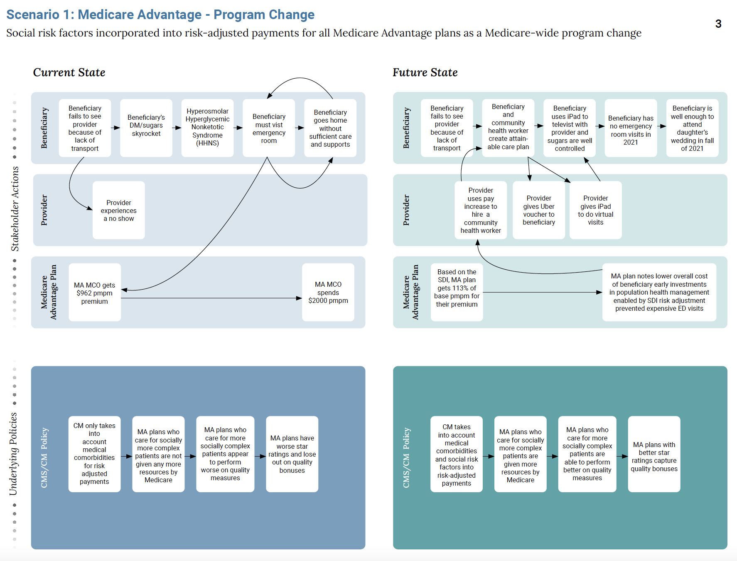
Notes:
Chad David Arlene Tamyra Rank
1. Data standards High High High High 2
1.a. Need standards to apply to EHR vendors to enable evaluation, care support, interop
1.b. Need common SDH data for adjustment
2. Political will of government High Medium High High 1
2a. Rule-making process dependent on political will of stakeholders
3. Measurement methodology overall High High High High 3
3.a. Developing health equity measures and improvement
3.b. How SDH data are employed to adjust payments
4. Regulation to ensure equity dollars go to improve health/health care of vulnerable populations High High High High 4
4.a. Dollars go to plans that need them
4.b. They apply them to their high-need patients
4.c. They receive enough to meet patient needs
4.d. They apply them in ways that serve patient needs
Constraint: payment adjustment based on small-area measures; social needs to be met based on patient’s particulars
We’re not addressing resource needs for social services and community organizations to whom this process will direct more referrals and requests for help

Slide 79
Scenario 2: Medicare Advantage - CMMI Model

Slide 80
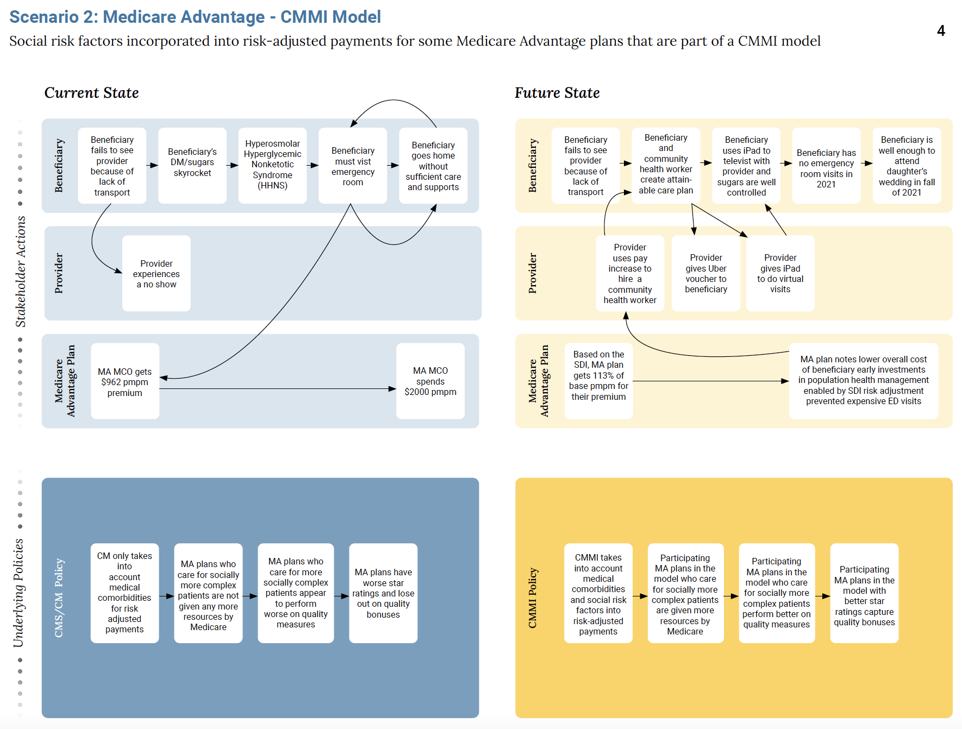
Notes:
Risk adjustment needs to be tested
Who is provider? Institution or clinician
Shared risk outcome model?
Track where increased spending w/ positive impact on outcomes
Challenges: two care managers, ACO or Plan duplicating efforts with one beneficiaries
If we were to offer increased risk adjustment payments will we ask for greater link to quality in a CMMI pilot? Will flexibility to spend be linked to healthier outcomes?
A model could ask for more individual level data
Community v. individual specific data collection is difficult so you have to do both
What is the impact of something like this on Health Equity?
Data standards not required for implementation but rather measuring impact b.c SDI indices already exist
Start with the Data to understand value of provision of health services
Updated top drivers
1B. Data standards - risk adjustment, provider efforts, outcomes measurement, standardization of definitions
2 Political will of government - unless mandatory model, hard to implement b/c cost burden on stakeholders to test
1A Measurement methodology overall - not just risk adjustment but rather who are we measuring and what are they held accountable for (improve health beneficiary health outcomes)
3Regulation to ensure equity dollars go to improve health/health care of vulnerable populations - N/A unless mandatory

Slide 81
Scenario 3: Medicare FFS - CMMI Model

Slide 82
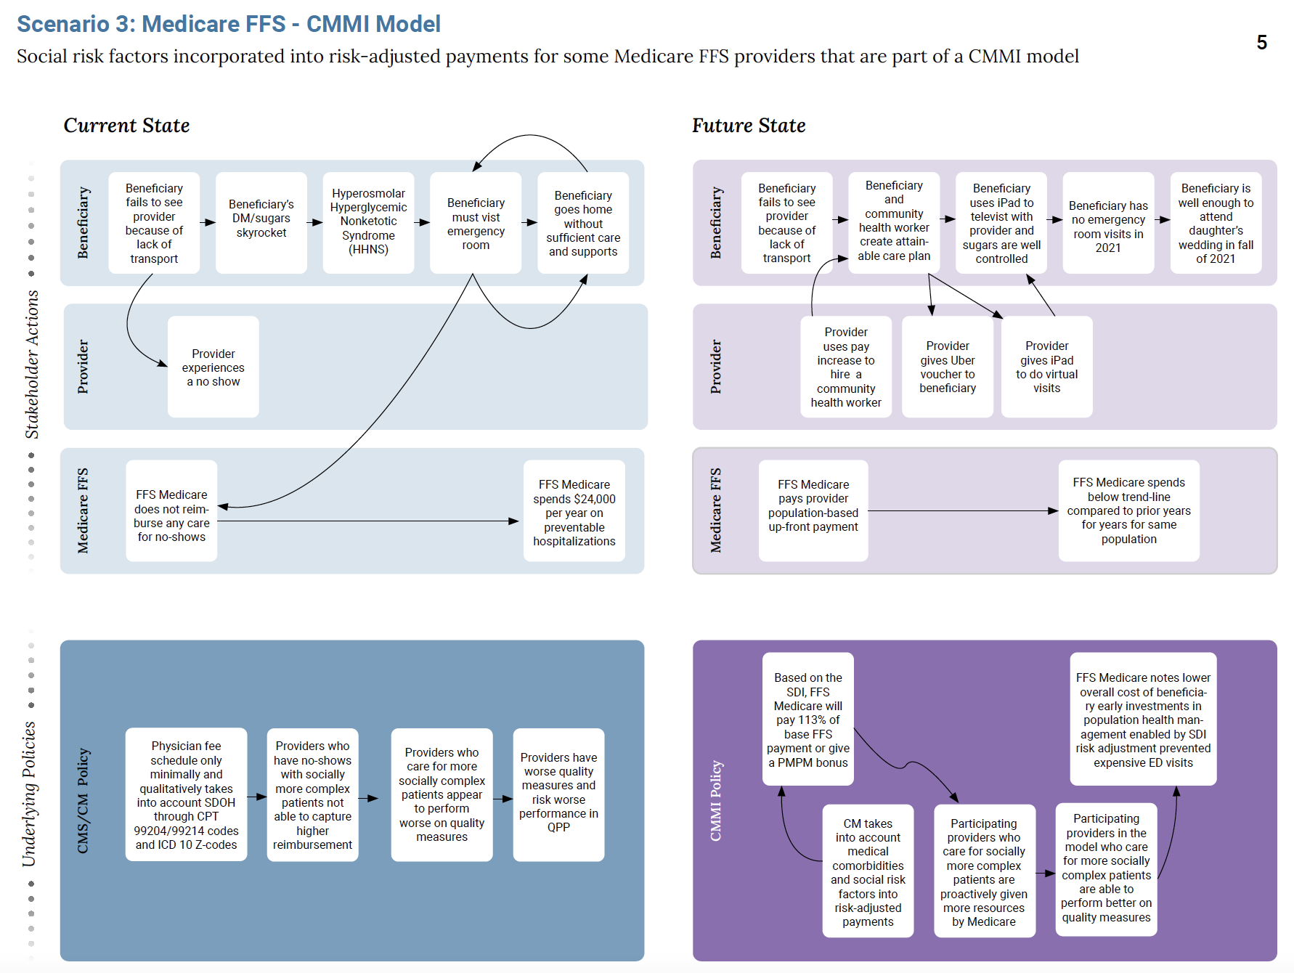

Slide 83
Scenario 4: Medicaid Program

Slide 84
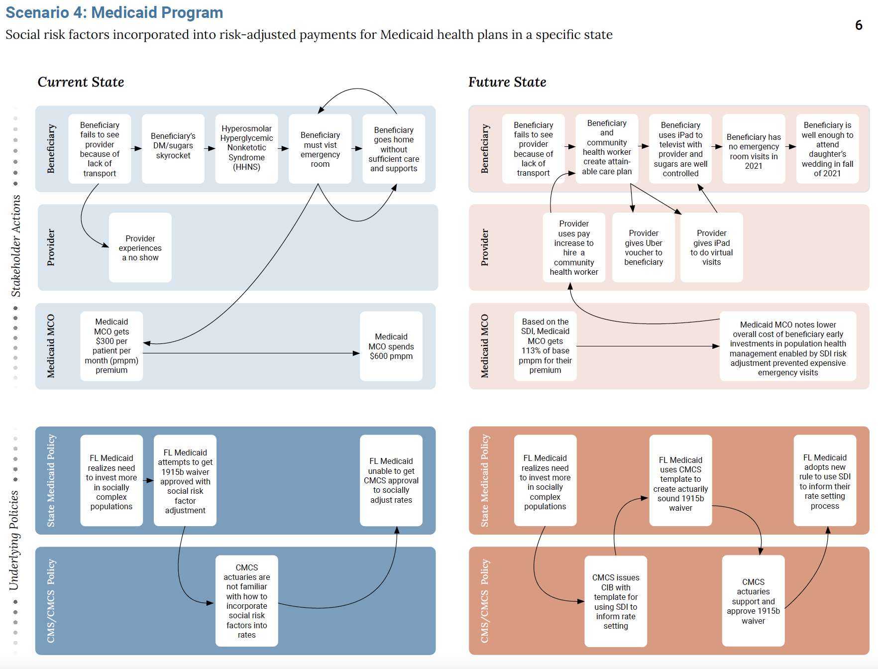

Slide 85
Small Group Exercise
Testing Future States Against Drivers

Slide 86
Activity Breakdown
Sort into breakout rooms with facilitators (1 minute)
Each group facilitator will review the top 5 drivers determined in the earlier larger group session and the group’s assigned future state (10 min)
Invite each participant to test the top 5 drivers against their assigned future state (5 min)
Low
Medium
High
The group will discuss and come to consensus (15 min)
Choose one participant to share outcomes in large group (1 min)

Slide 87
Drivers | Ranking
Data standards | 2
Political will of government | 1
Measurement methodology overall | 3
Regulation to ensure equity dollars go to improve health/health care of vulnerable populations | 4
Driver 5
Testing Drivers
Notes:
1. Data standards High High High High 2
1.a. Need standards to apply to EHR vendors to enable evaluation, care support, interop
1.b. Need common SDH data for adjustment
2. Political will of government High Medium High High 1
2a. Rule-making process dependent on political will of stakeholders
3. Measurement methodology overall High High High High 3
3.a. Developing health equity measures and improvement
3.b. How SDH data are employed to adjust payments
4. Regulation to ensure equity dollars go to improve health/health care of vulnerable populations High High High High 4
4.a. Dollars go to plans that need them
4.b. They apply them to their high-need patients
4.c. They receive enough to meet patient needs
4.d. They apply them in ways that serve patient needs
Constraint: payment adjustment based on small-area measures; social needs to be met based on patient’s particulars
We’re not addressing resource needs for social services and community organizations to whom this process will direct more referrals and requests for help

Slide 88
Group 1
Facilitator: Bob

Slide 89
Testing Future States Against Drivers Activity Goal
OUR goal is to determine the impact of the drivers on our group’s assigned future state.
Ultimately, this analysis will help the larger group decide what future state to move forward with.

Slide 90
Testing Drivers: Review and Analyze
Together let’s review our group’s assigned future state and the drivers (10 min)
Next, let’s take 5 minutes and rate each of the drivers against the future state. Send them to me via the Zoom chat.
Your answer might look something like… -Driver 1: low
-Driver 2: high
-Driver 3: medium
Notes:
Facilitator leave this slide up for the 5 minutes.

Slide 91
Testing Drivers: Share, Review, & Gain Consensus as a Group
As a group, let’s review all of the ratings we have compiled. We will do this on the next slide in the speaker notes.
Once we have reviewed them, we finalize our analysis and share with the larger group
Notes:
Facilitator flip to next slide

Slide 92
Drivers | Rating
Driver 1
Driver 2
Driver 3
Driver 4
Driver 5
Testing Drivers, Group 1
Medicare Advantage- Program Change
Notes:
Facilitator, please copy and paste participant answers below. For an easier view, drag up the bar above to give more space for speaker notes. (10 min)
After collecting all answers, as a group, review and come to consensus on each driver rating.
Driver 1:
Word
Driver 2:
Word
Driver 3:
Word
Driver 4:
Word
Driver 5:
Word

Slide 93
Group 2
Facilitator: Kevin

Slide 94
Testing Future States Against Drivers Activity Goal
OUR goal is to determine the impact of the drivers on our group’s assigned future state.
Ultimately, this analysis will help the larger group decide what future state to move forward with.
Notes:
Just a reminder, Medicaid is also a focus today, a goal is to arrive at a default approach that states can use or apply to amend, instead of the current process where they have to apply and offer methodology for payment adjustment--leading to some states developing good plans, some not even trying, and potential for poor alignment across states

Slide 95
Testing Drivers: Review and Analyze
Together let’s review our group’s assigned future state and the drivers (10 min)
Next, let’s take 5 minutes and rate each of the drivers against the future state. Send them to me via the Zoom chat.
Your answer might look something like… -Driver 1: low
-Driver 2: high
-Driver 3: medium
Notes:
Facilitator leave this slide up for the 5 minutes.

Slide 96
Testing Drivers: Share, Review, & Gain Consensus as a Group
As a group, let’s review all of the ratings we have compiled. We will do this on the next slide in the speaker notes.
Once we have reviewed them, we finalize our analysis and share with the larger group
Notes:
Facilitator flip to next slide

Slide 97
Drivers | Rating
Measurement methodology overall - not just risk adjustment but rather who are we measuring and what are they held accountable for (improve health beneficiary health outcomes) | 1A
Data standards - risk adjustment, provider efforts, outcomes measurement, standardization of definitions | 1B
Political will of government - unless mandatory model, hard to implement b/c cost burden on stakeholders to test | 2
Regulation to ensure equity dollars go to improve health/health care of vulnerable populations - N/A unless mandatory | 3
Testing Drivers, Group 2
Medicare Advantage- CMMI Model
Notes:
Facilitator, please copy and paste participant answers below. For an easier view, drag up the bar above to give more space for speaker notes. (10 min)
After collecting all answers, as a group, review and come to consensus on each driver rating.
Driver 1:
Word
Driver 2:
Word
Driver 3:
Word
Driver 4:
Word
Driver 5:
Word

Slide 98
Group 3
Facilitator: Andrew

Slide 99
Testing Future States Against Drivers Activity Goal
OUR goal is to determine the impact of the drivers on our group’s assigned future state.
Ultimately, this analysis will help the larger group decide what future state to move forward with.

Slide 100
Testing Drivers: Review and Analyze
Together let’s review our group’s assigned future state and the drivers (10 min)
Next, let’s take 5 minutes and rate each of the drivers against the future state. Send them to me via the Zoom chat.
Your answer might look something like… -Driver 1: low
-Driver 2: high
-Driver 3: medium
Notes:
Facilitator leave this slide up for the 5 minutes.

Slide 101
Testing Drivers: Share, Review, & Gain Consensus as a Group
As a group, let’s review all of the ratings we have compiled. We will do this on the next slide in the speaker notes.
Once we have reviewed them, we finalize our analysis and share with the larger group
Notes:
Facilitator flip to next slide

Slide 102
1. Data standards - need comprehensive, consistent, easily shared data - MEDIUM
Build off of Gravity Project (screening, diagnosis, intervention documentation, identifying and harmonizing social risk factor data for interoperable electronic health information exchange not so much Accountable Health Communities
Use data standards concept but we need to know what actually happens
These are tools for ensuring accountability
2. Political will of government - HIGH
Biden Admin highly supportive of modifying FFS; many would like to move to risk-based payment as fast as possible
Strong Executive and CMS will to layer additional value based care or capitation onto FFS
Legislative barrier: If requires Congress, this approach goes nowhere (Medicare for All caucus strong)
CMMI is best path - we can do most of scenario right now
3. Measurement methodology overall - MEDIUM
Lots of options, but not a clear methodology yet for FFS; must choose which one to build around
Likely add on payment, bundled pymt
Lots of different measures and paths to test; SDI not only measure
4. Accountability - Regulation to ensure equity dollars go to improve health/health care of vulnerable populations - MEDIUM
If in this model, you’re accountable for improved health/care of vulnerable. How? If we give you additional PMPM, we expect QI ROI
Best path if lim to FFS is to add capitated payment on top of current FFS; accountability challenging for small groups/practices
CMMI well positioned to act
Providing stronger incentives to move towards capitated payment & risk (not specific benefit)
Pay extra money to move folks to do a list of things for specific items
Testing Drivers, Group 3
Medicare FFS- CMMI Model
Notes:
Facilitator, please copy and paste participant answers below. For an easier view, drag up the bar above to give more space for speaker notes. (10 min)
After collecting all answers, as a group, review and come to consensus on each driver rating.
1. Data standards - need comprehensive, consistent, easily shared data
Build off of Gravity Project (screening, diagnosis, intervention documentation), not so much Accountable Health Communities
Use data standards concept but we need to know what actually happens
These are tools for ensuring accountability
2. Political will of government -
We think they’ll be supportive
Will to layer additional value based care or capitation onto FFS
If requires Congress, this approach goes nowhere (Medicare for All caucus strong)
CMMI is best path
3. Measurement methodology overall
What is methodology in FFS around which to build
Add on payment, bundled pymt
Lots of different ways to pay differently - Add on payment
4. Accountability - Regulation to ensure equity dollars go to improve health/health care of vulnerable populations - LOW
If in this model, you’re accountable for improved health/care of vulnerable.
How? If we give you additional PMPM, we expect QI ROI
Best path if lim to FFS is to add capitated payment on top of current FFS
CMMI positioned to act
Providing stronger incentives to move towards capitated payment & risk (not specific benefit)
Pay extra money to move folks to do a list of things for specific items
LAURA: No objection to future state; but limited; only one viable path.
-SDI alone not only path
-Future state is a value-based component; some kind of capitation payment
When we think about doing this in FFS; E&M coding deadline change the game
When talking about MA, holding a much larger entity accountable than individual clinician in FFS
Other levers come to bear; for those paid
Do we want a middle and then in
Shannon - we can do most of this right now; this is an organizational PMPM arrangement
-Thinks we’re 3 steps from doing this now
-Clarification: CMMI is running models, not CM (but exists in a vacuum)
-DATA - AHC model was one of the first orgs to collect SDH data, but no standard, difficult to do that; needs to
-Primary Care First already allows for some flexibility
-As long as capitated payment with right waivers
-MA plans are still under limited threshold for risk-based contracts
Allyson:
Feels so limited
Issue is not about adding a service to FFS, but about adding risk
Bundled payment for transportation, Value-based payment, Capitation much more appropriate
Must add an element of risk
Requires specificity of need to determine payment? What if not transportation, but an A/C?
If you’ve never taken risk for anything, is this the thing you’re going to take risk for first
Far better to move ASAP to risk based care
Geographically assigned Medicare
Susannah -

Slide 103
Group 4
Facilitator: Andrey

Slide 104
Testing Future States Against Drivers Activity Goal
OUR goal is to determine the impact of the drivers on our group’s assigned future state.
Ultimately, this analysis will help the larger group decide what future state to move forward with.

Slide 105
Testing Drivers: Review and Analyze
Together let’s review our group’s assigned future state and the drivers (10 min)
Next, let’s take 5 minutes and rate each of the drivers against the future state. Send them to me via the Zoom chat.
Your answer might look something like… -Driver 1: low
-Driver 2: high
-Driver 3: medium
Notes:
Facilitator leave this slide up for the 5 minutes.

Slide 106
Testing Drivers: Share, Review, & Gain Consensus as a Group
As a group, let’s review all of the ratings we have compiled. We will do this on the next slide in the speaker notes.
Once we have reviewed them, we finalize our analysis and share with the larger group
Notes:
Facilitator flip to next slide

Slide 107
Drivers | Rating
Driver 1
Driver 2
Driver 3
Driver 4
Driver 5
Testing Drivers, Group 4
Medicaid Program
Notes:
Facilitator, please copy and paste participant answers below. For an easier view, drag up the bar above to give more space for speaker notes. (10 min)
After collecting all answers, as a group, review and come to consensus on each driver rating.
Driver 1:
Word
Driver 2:
Word
Driver 3:
Word
Driver 4:
Word
Driver 5:
Word

Slide 108
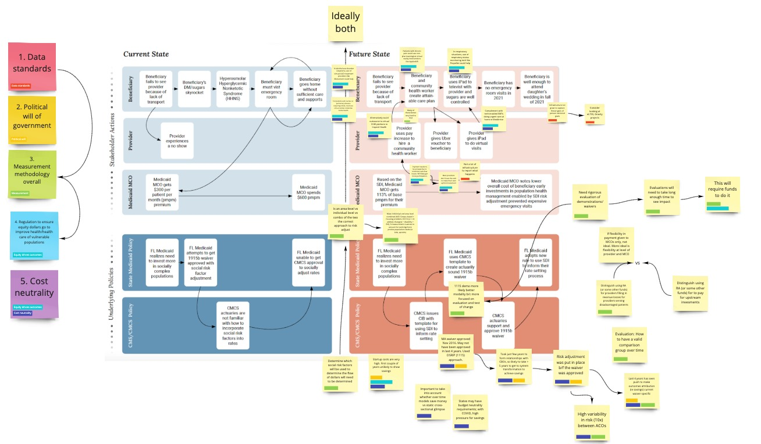
Drivers | Rating
Driver 1
Driver 2
Driver 3
Driver 4
Driver 5
Testing Drivers, Group 4
Medicaid Program
Notes:
https://miro.com/app/board/o9J_lZQxqOQ=/
Facilitator, please copy and paste participant answers below. For an easier view, drag up the bar above to give more space for speaker notes. (10 min)
After collecting all answers, as a group, review and come to consensus on each driver rating.
Driver 1:
Word
Driver 2:
Word
Driver 3:
Word
Driver 4:
Word
Driver 5:
Word

Slide 109
Group Vote
Which future state should we pursue as an actionable path forward?
(Note: all future states or additions you might have will be considered for next steps)

Slide 110
Short Break

Slide 111
Energizer

Slide 112
Group Exercise
Developing a Plan for Action

Slide 114
Activity Breakdown
Identify the key differences between the present and the preferred future state/policy objectives
Build a timeline that sets out the key changes needed to move from the present reality to the preferred future
Identify which changes are in the group’s control and which aren’t and determine next steps
Identify what the group needs to do to deliver the steps that are in their control
Identify how the group can influence or facilitate the steps that are outside of their control

Slide 115
Present
Preferred Future State
Word
Word
Word
Word
Word
Word
Word
Word
Word
Word
Notes:
Facilitator: Let’s talk through the key differences between the present and the preferred future state. In the chat drop some of the aspects of our current state. If you have a thought please raise your hand.
OK now what are some aspects of the future state. Again, in the chat drop some of the aspects of our current state. If you have a thought please raise your hand. [20 min]
Beyond transportation-- meet other social needs
Accountability

Slide 116
Timeline Building
Word
Word
Word
Word
Word
Word
Word
Word
Word
Word
Notes:
Facilitator:
OK so now let’s build a timeline. What actions need to get done in order for us to move from the present reality to the preferred future state? [30 min]
Now, that we have a timeline. Let’s go over what steps are in our control and which out of our control? How can we work to influence those steps that are out of our control? [ 30 min]

Slide 117
Next Steps
Word
Word
Word
Word
Word
Notes:
Facilitator: What are the next steps we can take today? [20 min]

Slide 118
Closing Remarks
Andrey Ostrovsky, MD, Social Innovation Ventures

