Slide 1

Leveraging Research to Address Social Determinants of Health
June 3, 2019
Amy Kind, MD, PhD
Director, Department of Medicine Health Services and Care Research Program
Associate Professor, Department of Medicine, Division of Geriatrics
Core Leader, Care Research Core, Wisconsin Alzheimer’s Disease Research Center (ADRC)
University of Wisconsin School of Medicine and Public Health;
ajk@medicine.wisc.edu

Slide 2
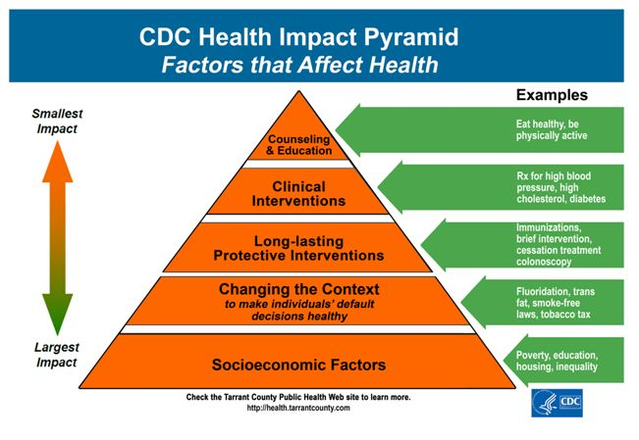

Slide 3
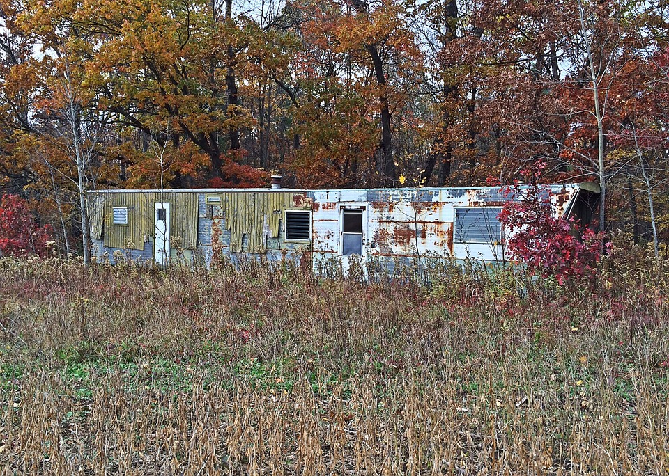
Neighborhood Disadvantage
Alzheimer’s disease, diabetes, heart disease and many other conditions disproportionately impact racial/ethnic minorities and the socioeconomically disadvantaged—populations often exposed to neighborhood disadvantage, a social determinant of health
  [Link & Phelan, J Health Soc Behav, 1995; ]
Neighborhood disadvantage influences many factors including health behaviors, access to food, toxic exposures and personal safety
[Link & Phelan, J Health Soc Behav, 1995; House et al, Milban Q, 1990; Franco et al, Am J Prev Med, 2008; and others]
Living in a disadvantaged US neighborhood is strongly linked to increased mortality and disease
  [Kind et al, Annals of Int Med, 2014; Link & Phelan, J Health Soc Behav, 1995; House et al, Milban Q, 1990; and others]
Source: www.Pixabay.com-- All images are released free of copyrights under Creative Commons CC0

Slide 4
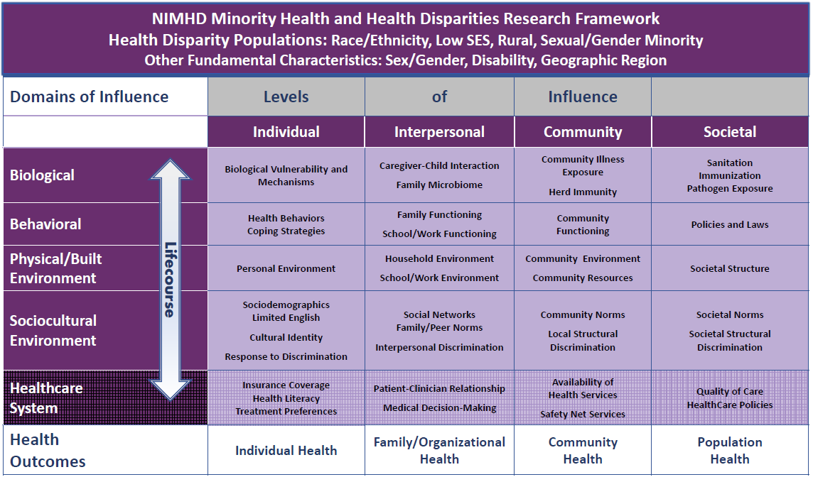
Context is fundamental to almost all theoretical mechanisms of health disparities
Source: https://www.nimhd.nih.gov/images/research-framework-slide.pdf

Slide 5
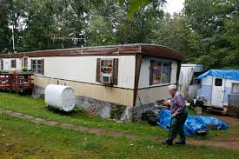
Potential of Geospatial Metrics of Neighborhood Disadvantage
Metrics of Neighborhood Disadvantage are Robust:
  Generalizable to full US and Puerto Rico
  Incorporate into predictive analytics
  Facilitate mechanistic science across health conditions
  Privacy-compliant
  Strong track record of application – mostly abroad
Translatable: Actionable at person, community, research and policy levels
  Guide outreach, targeting- particularly through mapping
  Influence intervention design, implementation
  Policy-applicable: eligibility, adjustment, resources, etc
Underutilized: Yet, despite all this potential, greatly underutilized in the US-- not easily accessible nor always in a format that allows wide applicability
Source: www.Pixabay.com-- All images are released free of copyrights under Creative Commons CC0

Slide 6

Area Deprivation Index
(ADI)
Originally created by Health Resources and Services Administration nearly three decades ago and employed at the county level
17 education, employment, housing-quality and poverty measures originally drawn from long-form Census
Limitations mirror those of parent data
Required updates for modern use
UW team:
  Updated to more recent and relevant data sources (American Community Survey, 2009-13)
  Refined down to census block-group level (i.e. “neighborhood” ~ 1,500 persons) which is critical to more precisely measure exposure
  NIH R01 to validated these changes with users across US
Source: www.Pixabay.com-- All images are released free of copyrights under Creative Commons CC0

Slide 7
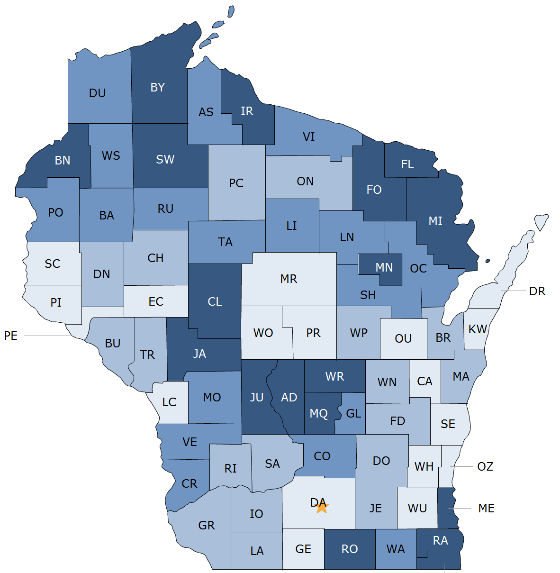
Typical
Geo-Political Boundaries Employed in Identification of Contextual Disadvantage

Slide 8
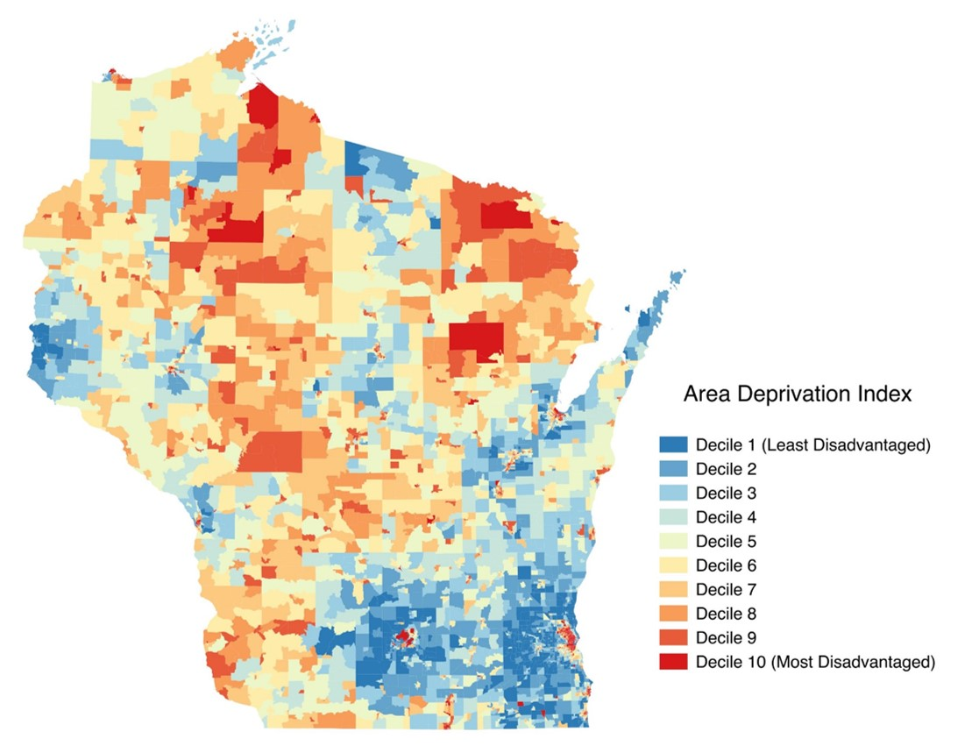
Neighborhood Disadvantage by ADI

Slide 9
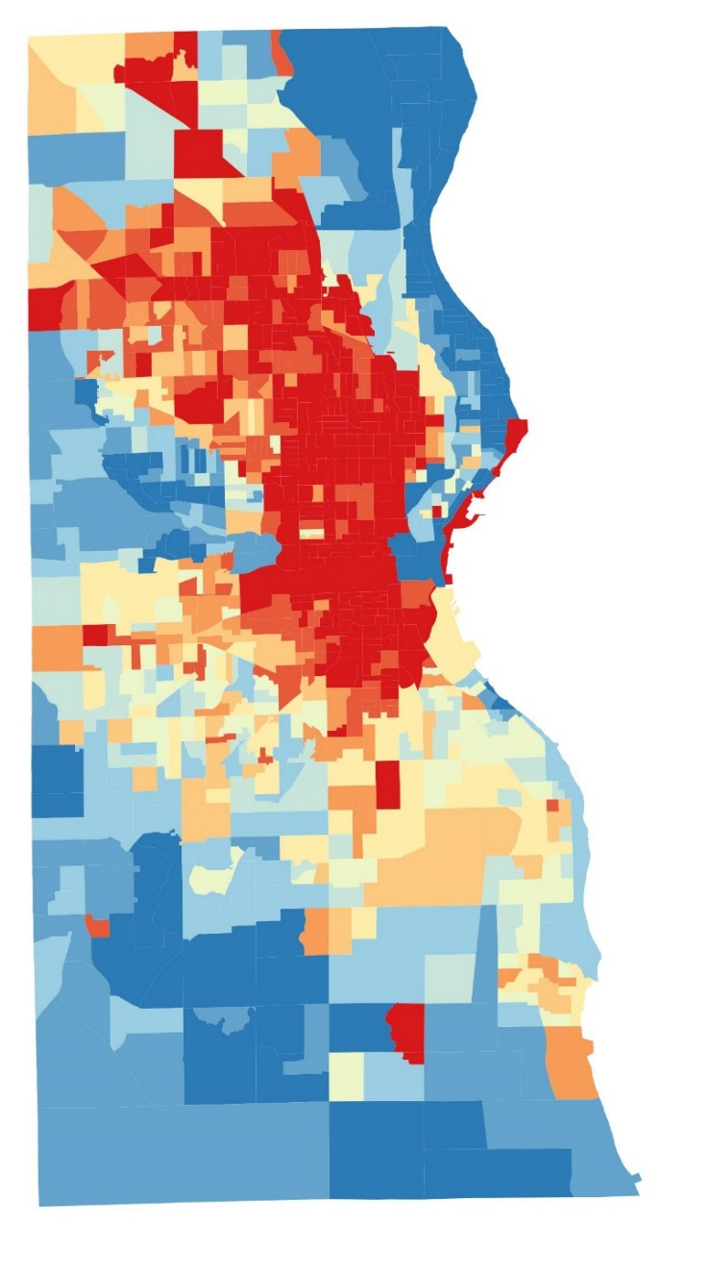

Milwaukee County

Slide 10
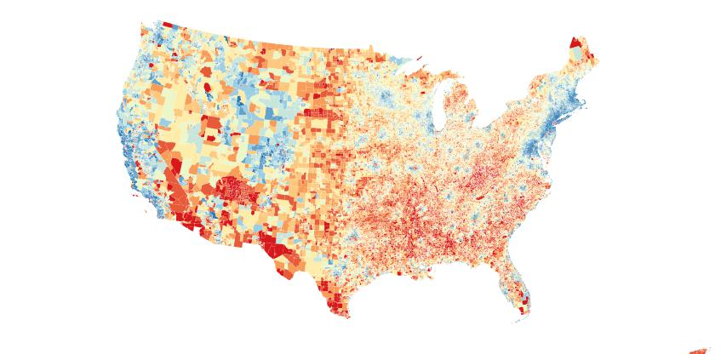

Slide 11
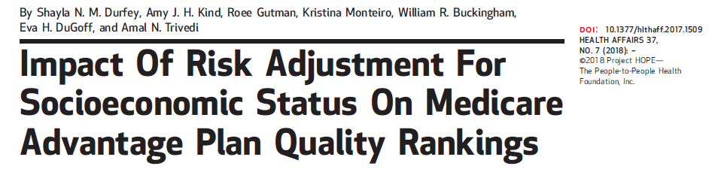
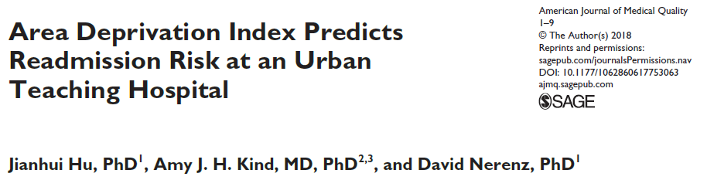
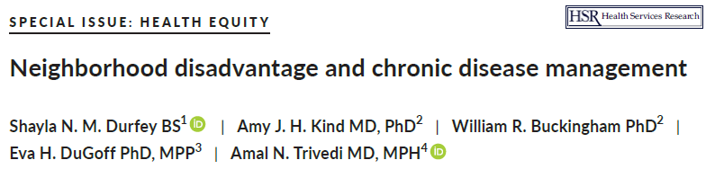

Slide 12
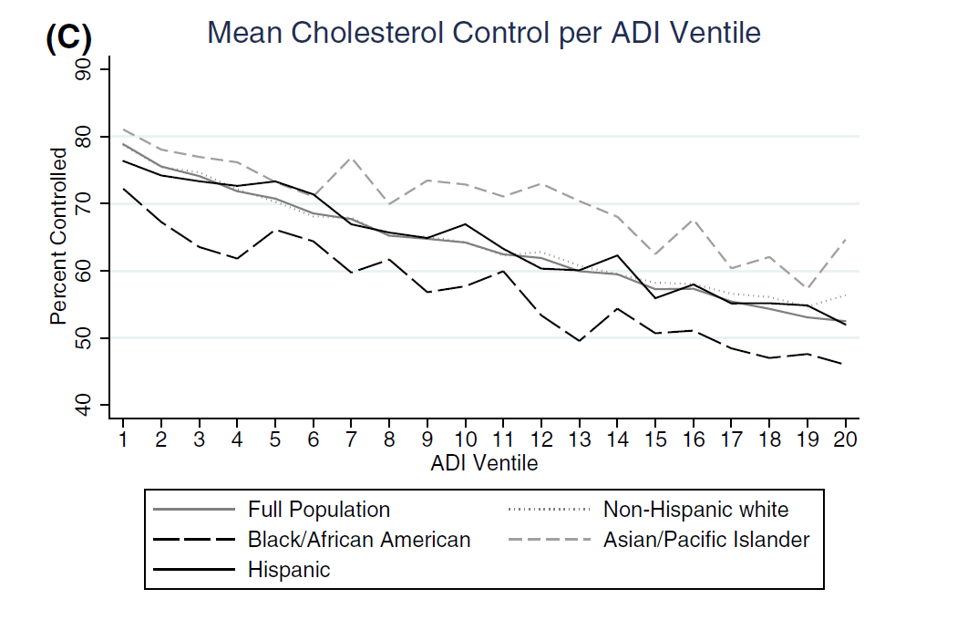
Neighborhood Disadvantage and Cholesterol Control
in Medicare Advantage
*Durfey et al, HSR, 2019

Slide 13
Examples:
Neighborhood Disadvantage by ADI
and Health
Research---Living in a highly disadvantaged neighborhood:
  Rehospitalization and cost
  [Kind et al, Annals, 2014; Hu et al, AJMQ, 2018]
  AD-specific CSF biomarkers, cognitive loss; hippocampal volumes
  [Kind et al, Alz Assoc Annual Meeting, 2017; Hunt et al, Alz Assoc Annual Meeting, 2018]
  CMV seroprevalence in pregnancy
  [Lantos et al, J Racial and Ethnic Health Disparities, 2018]
  Skin infection and deafness in childhood
  [Lantos et al, manuscripts in submission, 2018]
  Functional loss, many others…
  [Jung et al, JAGS, 2018]
Source: www.Pixabay.com-- All images are released free of copyrights under Creative Commons CC0

Slide 14
Examples:
Neighborhood Disadvantage by ADI
and Health
Policy– Multiple state-based health organizations
  Catalyze new partnerships among communities, health systems and governments to advocate for policies addressing social factors that influence health
Delivery –
  Outreach, targeting to disadvantaged neighborhoods
  Designing for low-resource settings
Source: www.Pixabay.com-- All images are released free of copyrights under Creative Commons CC0

Slide 15
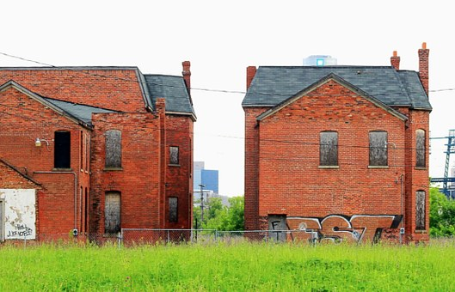
How do we catalyze greater change?
© cnbc.com
Source: www.Pixabay.com-- All images are released free of copyrights under Creative Commons CC0

Slide 16
Data Democratization
Making complex data easily available to wide-reaching expert and non-expert audiences to massively broaden uptake and use of critical concepts and tools
Extremely challenging to practically achieve due to technical challenges of big data
Source: www.Pixabay.com-- All images are released free of copyrights under Creative Commons CC0

Slide 17
Data Democratization
The Neighborhood Atlas
  https://www.neighborhoodatlas.medicine.wisc.edu/
  A free research tool which makes neighborhood disadvantage metrics for the full US including Puerto Rico accessible through real-time customized mapping and easily linkable data downloads
  No geoanalytics or other advanced degree is required to use the Atlas
  Anyone can map areas of interest or look up specific addresses
  Data downloads include a crosswalk of approximately 70 million nine-digit zip codes which enables linkage to most NIH research resources
Source: www.Pixabay.com-- All images are released free of copyrights under Creative Commons CC0

Slide 18
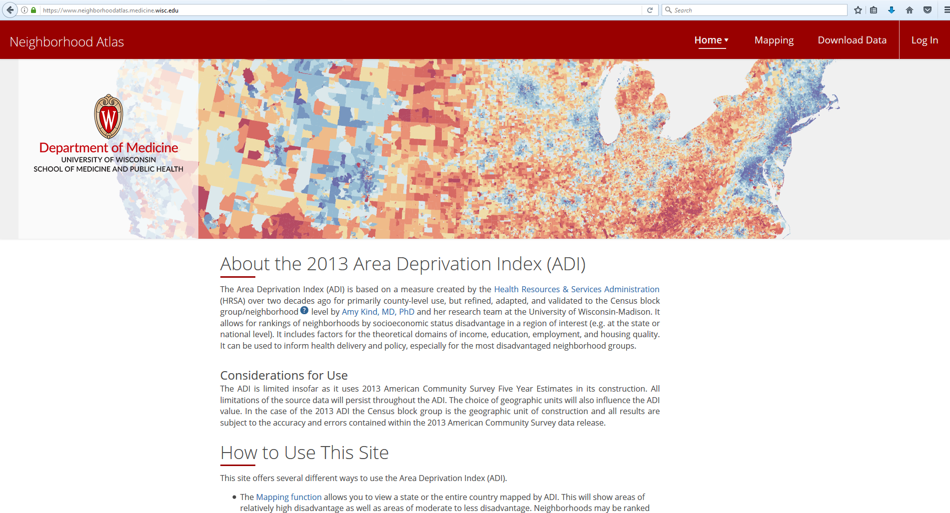
Neighborhood Atlas
https://www.neighborhoodatlas.medicine.wisc.edu/

Slide 19
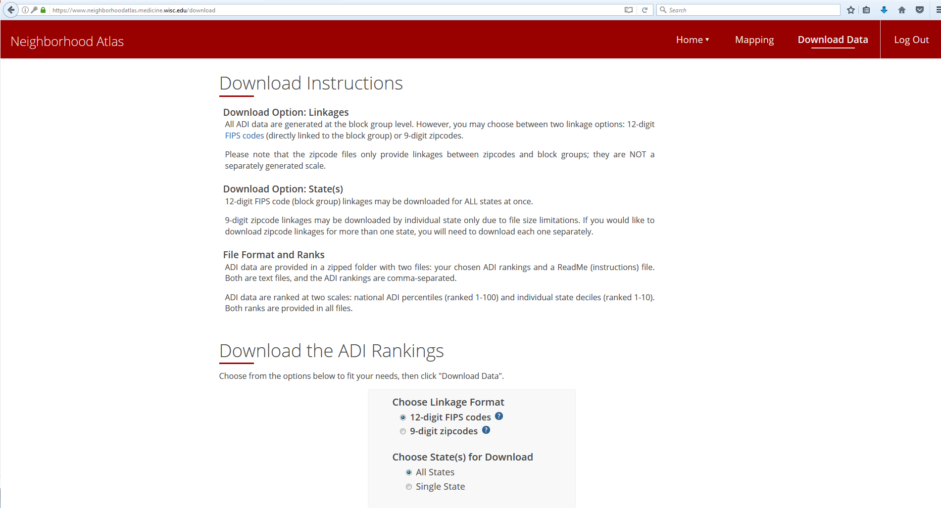
Neighborhood Atlas: Download Data
https://www.neighborhoodatlas.medicine.wisc.edu/

Slide 20
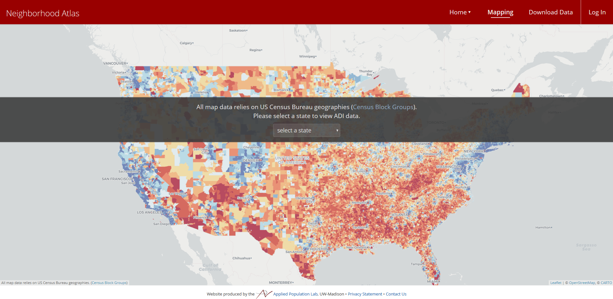
Neighborhood Atlas: Mapping
https://www.neighborhoodatlas.medicine.wisc.edu/

Slide 21
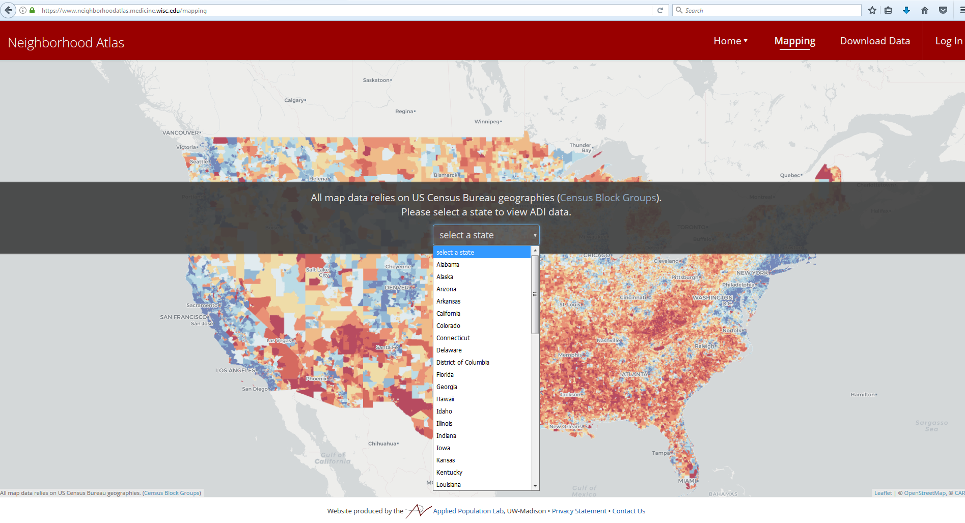
Neighborhood Atlas: Mapping
https://www.neighborhoodatlas.medicine.wisc.edu/

Slide 22
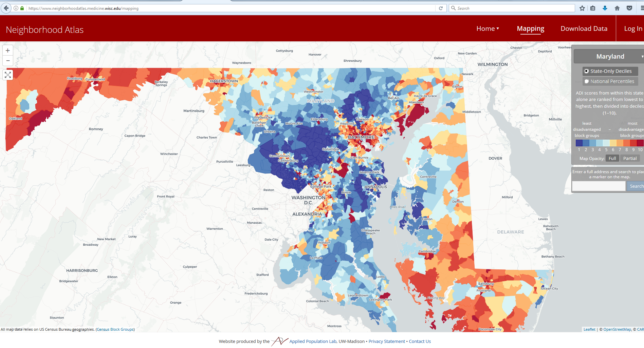
Neighborhood Atlas: Mapping
https://www.neighborhoodatlas.medicine.wisc.edu/

Slide 23
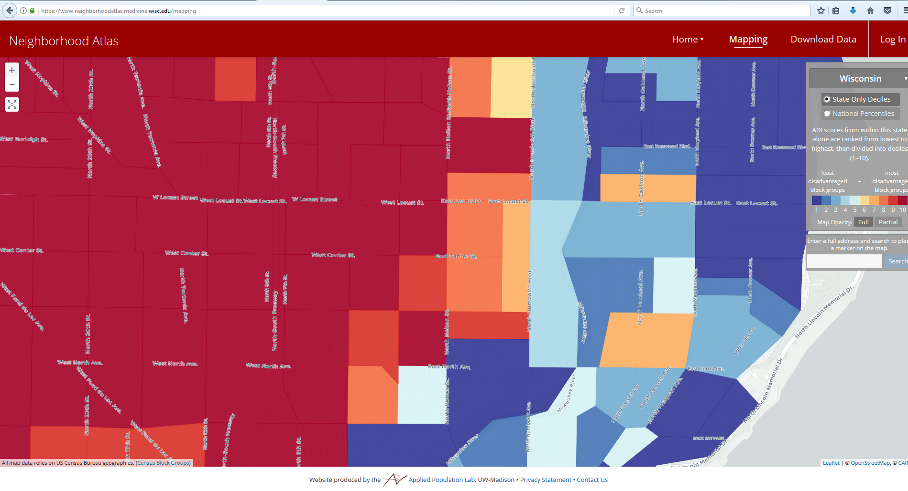
Neighborhood Atlas: Mapping
https://www.neighborhoodatlas.medicine.wisc.edu/

Slide 24
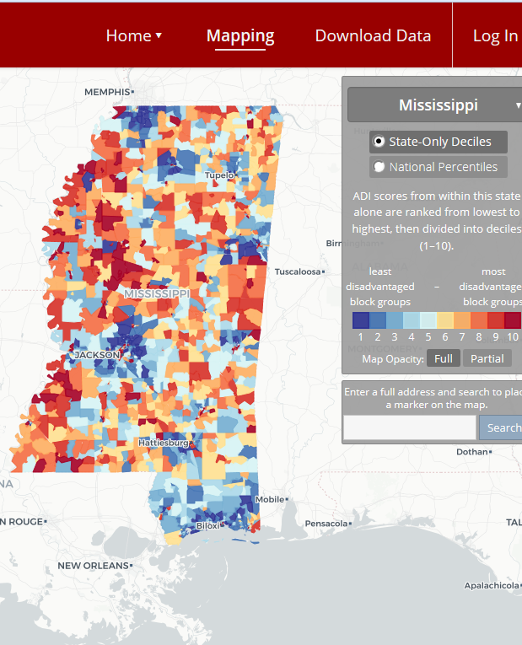
https://www.neighborhoodatlas.medicine.wisc.edu/

Slide 25
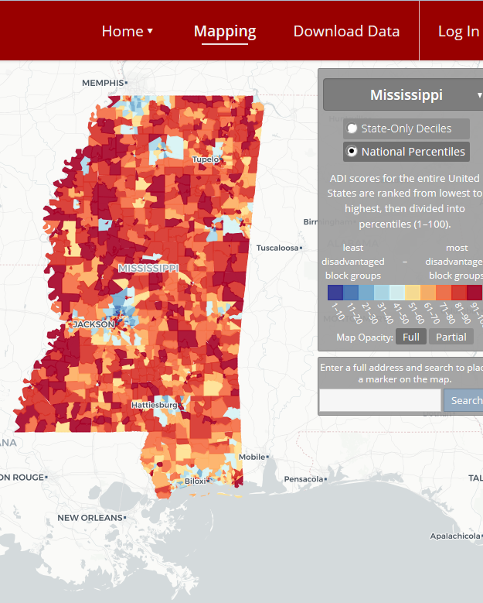
https://www.neighborhoodatlas.medicine.wisc.edu/

Slide 26
Kind AJH, Buckingham W. Making Neighborhood Disadvantage Metrics Accessible: The Neighborhood Atlas. New England Journal of Medicine, 378: 2456-2458; (2018)
Neighborhood Atlas Use
>100,000 views, vast majority focused on mapping
>8,300 data downloads
    US House of Representatives
    Social Security Administration
    NIH, CDC, VA, DOD, HHS
    AARP, AHA, ACS
    IBM Watson, EPIC
    Directors of global pharmaceutical companies, health systems and industry, others
Feedback = Positive and overwhelmingly thankful

Slide 27
Potential
Next Steps
Update ADI at least every 5 years; Update annually if resources allow
Explore offering additional measures on Atlas
Catalyze, inform translational research:
  Multi-stakeholder community intervention research to improve health
  Clinical trial and cohort recruitment, retention, analysis
  Epigenomics
Sociobiological Mechanisms of Disease: Study impact of dosage and timing of neighborhood disadvantage exposure over the life-course on biological mechanisms
  Alzheimer’s Disease (RF1AG057784)
  Others
Source: www.Pixabay.com-- All images are released free of copyrights under Creative Commons CC0

Slide 28
Conclusions
The social determinants of health, including neighborhood disadvantage, are some of the fundamental drivers of health and health disparities
Social determinants of health should be considered in the design, conduct and evaluation of research, clinical and policy initiatives
Neighborhood disadvantage can be quantified for purposes of research, clinical and policy application
Neighborhood Atlas
Source: www.Pixabay.com-- All images are released free of copyrights under Creative Commons CC0

Slide 29














Acknowledgements
Carol Hermann
Ryan Powell
Bill Buckingham
Jinn-ing Liou
Fang-fang Shi
Jamie Larson
Sarah Keller
Aldo Irizarry
Leigha Vilen
Julia Loosen
Kelsey Melah
Caitlin McKown
Alice Kim
Funding
NIH/NIMHD R01MD010243-01 (Kind PI)
NIA RF1AG057784 (Kind PI; Bendlin MPI)
UW Department of Medicine
US Department of Veterans Affairs

